Slide 1
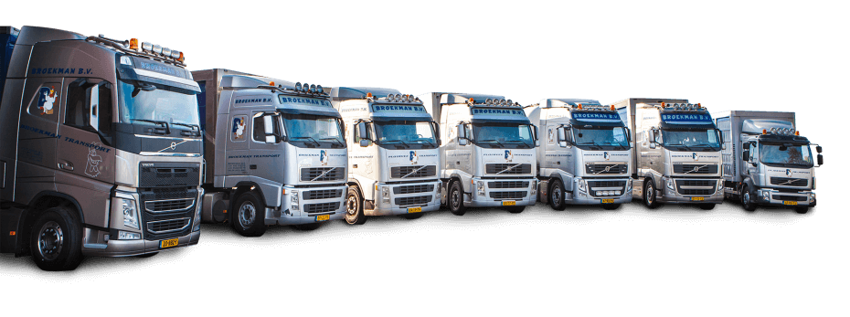
Building Human Resources Competency in Logistics Poultry Industry
Prepared & Shared by Yunus Triyonggo, PhD., CAHRI. (HR Director PT Sierad Produce, Tbk.)
Forum Logistik Peternakan Indonesia (FLPI) Workshop
Puslitbangnak-Bogor, 13 April 2018

Slide 2




Yunus Triyonggo
S-1 Teknologi Industri Pertanian IPB
S-2 Magister Management UNDIP
S-3 Sekolah Bisnis IPB
HR Trainee – Manager : PT Indofood Sukses Makmur, Tbk. (9 years)
Personnel & GA Manager : PT HM Sampoerna, Tbk. (1 year)
HRBP : PT Unilever Indonesia, Tbk (8 years)
VP HR : PT Nestle Indonesia (2 years)
Chief of Human Capital Development : PT Sierad Produce, Tbk (until now)
Organisasi:
Dewan Pakar PMSM 2016-2019
Pendiri LSP MSDM Indonesia
Ketua Umum Indonesia Human Resources Institute (IndHRI)
Wakil Komtap Standarisasi Kompetensi Ketenagakerjaan Kadin Pusat
Hobbies : tenis meja, jogging

Slide 3
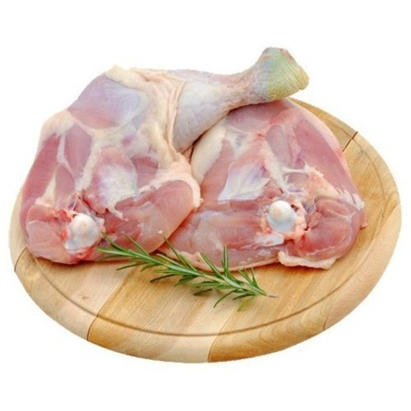
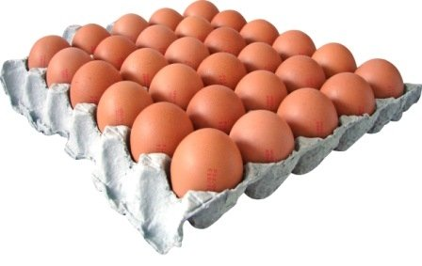
Facts & Figures
3.0 million MT of broiler meat produce in 2016, 100% more than in 2006
100% self-sufficient in broiler meat and table egg.
Poultry Consumption: Broiler Meat → 12 kg/capita
Egg : 150 eggs/capita
3.2 billion broiler docs produced in 2016, 100% more than 2006

Slide 4
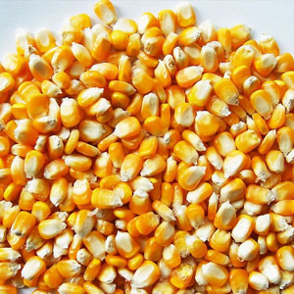
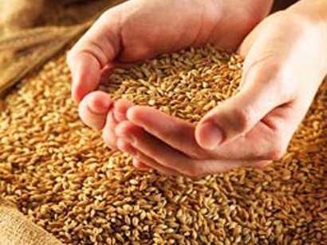
Facts & Figures
16.9 million tonnes feed produced in 2016, 100% more than in 2006
  80% raw material are import
  4 million MT soy bean meal imported in 2016 (second largest soy bean meal importer in the world).
  1.2 million MT corn imported in 2015

Slide 5
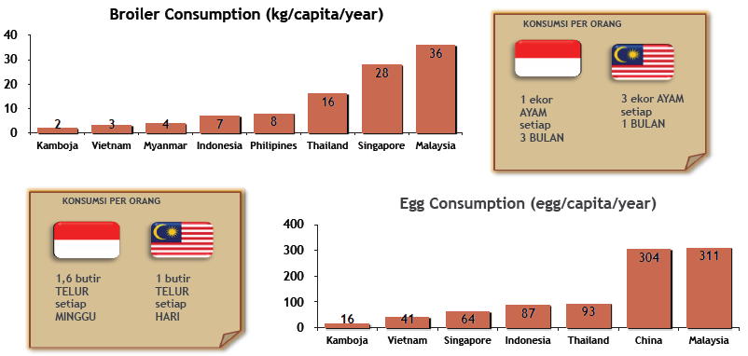
Facts & Figures

Slide 6
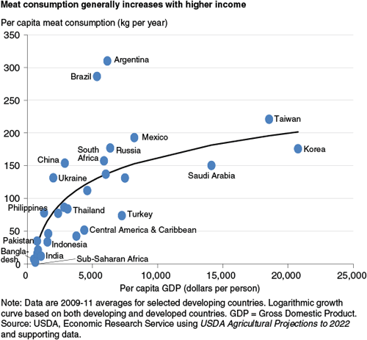
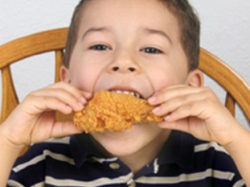
Chicken meat consumption trend

Slide 7
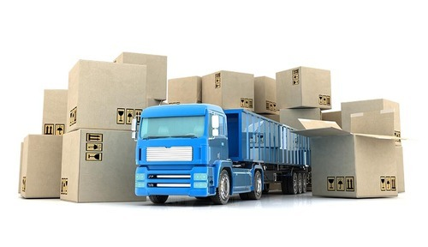
Logistics?
Logistics is a process which interfaces and interacts with the entire company and with external companies, vendors, customers, carriers and more.
Logistics is responsible for the movement of products from your vendors right through to the delivery at your customer's door, including moves through manufacturing facilities, warehouses, third-parties, such as repackagers or distributors.
It is not shipping and receiving, nor is it traffic or warehousing. It is more.
Source: http://www.ltdmgmt.com/five.php

Slide 8
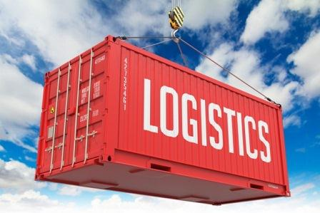
5 main issues in Logistics
Movement of product
Movement of information
Time/service
Cost
Integration

Slide 9
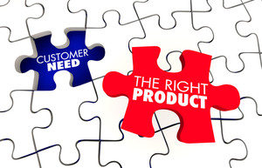
Logistics Goals
To meet specified customer service levels at the least total cost
Outcomes:
  the right product
  in the right quantity
  in the right condition
  to the right place
  at the right time
  the right customer
  at the right cost

Slide 10
Key Logistics Activities in Poultry Industry
Transportation Egg from Breeding Farm to Hatchery
Transportation DOC from Hatchery to Commercial Farm
Transportation Live Bird from Commercial Farm to Slaughterhouse
Transportation Dressed Chicken from SH to Customers
Cold Storage Dressed Chicken
Transportation Nugget, etc. from Warehouses to Distributors/ Agents
Further processed foods warehousing

Slide 11
Logistics KPIs
Parameter logistics yang dipergunakan pada umumnya antara lain:
1. Service level:
  Casefill,
  CCFOT (Casefill On Time),
  OTIF (On time In Full), atau
  DIFOT ( Delivery In Full On Time ).
2. Cost

Slide 12
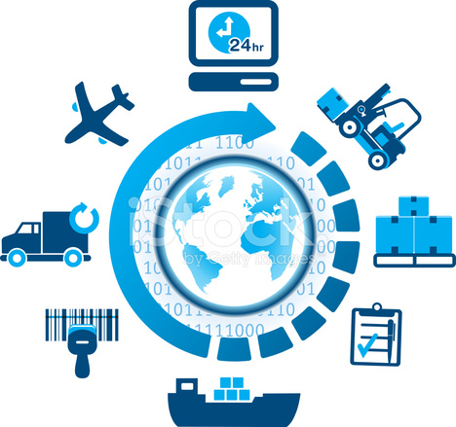
Logistics Components
ORDER PROCESSING
INVENTORY
WAREHOUSE
TRANSPORTATION
CUSTOMER SERVICE
EXPORT - IMPORT

Slide 13
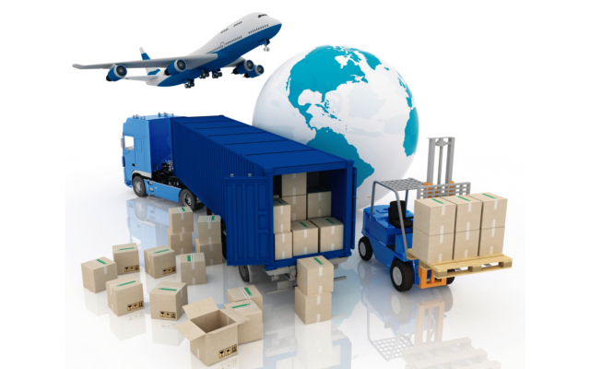

Logistics Cost
Average cost and utility created by major corporate functions
6 % Profit
20 % Logistics Cost = time + place utility
30 % Marketing Cost = possession utility
44 % Manufacturing Cost = form utility

Slide 14

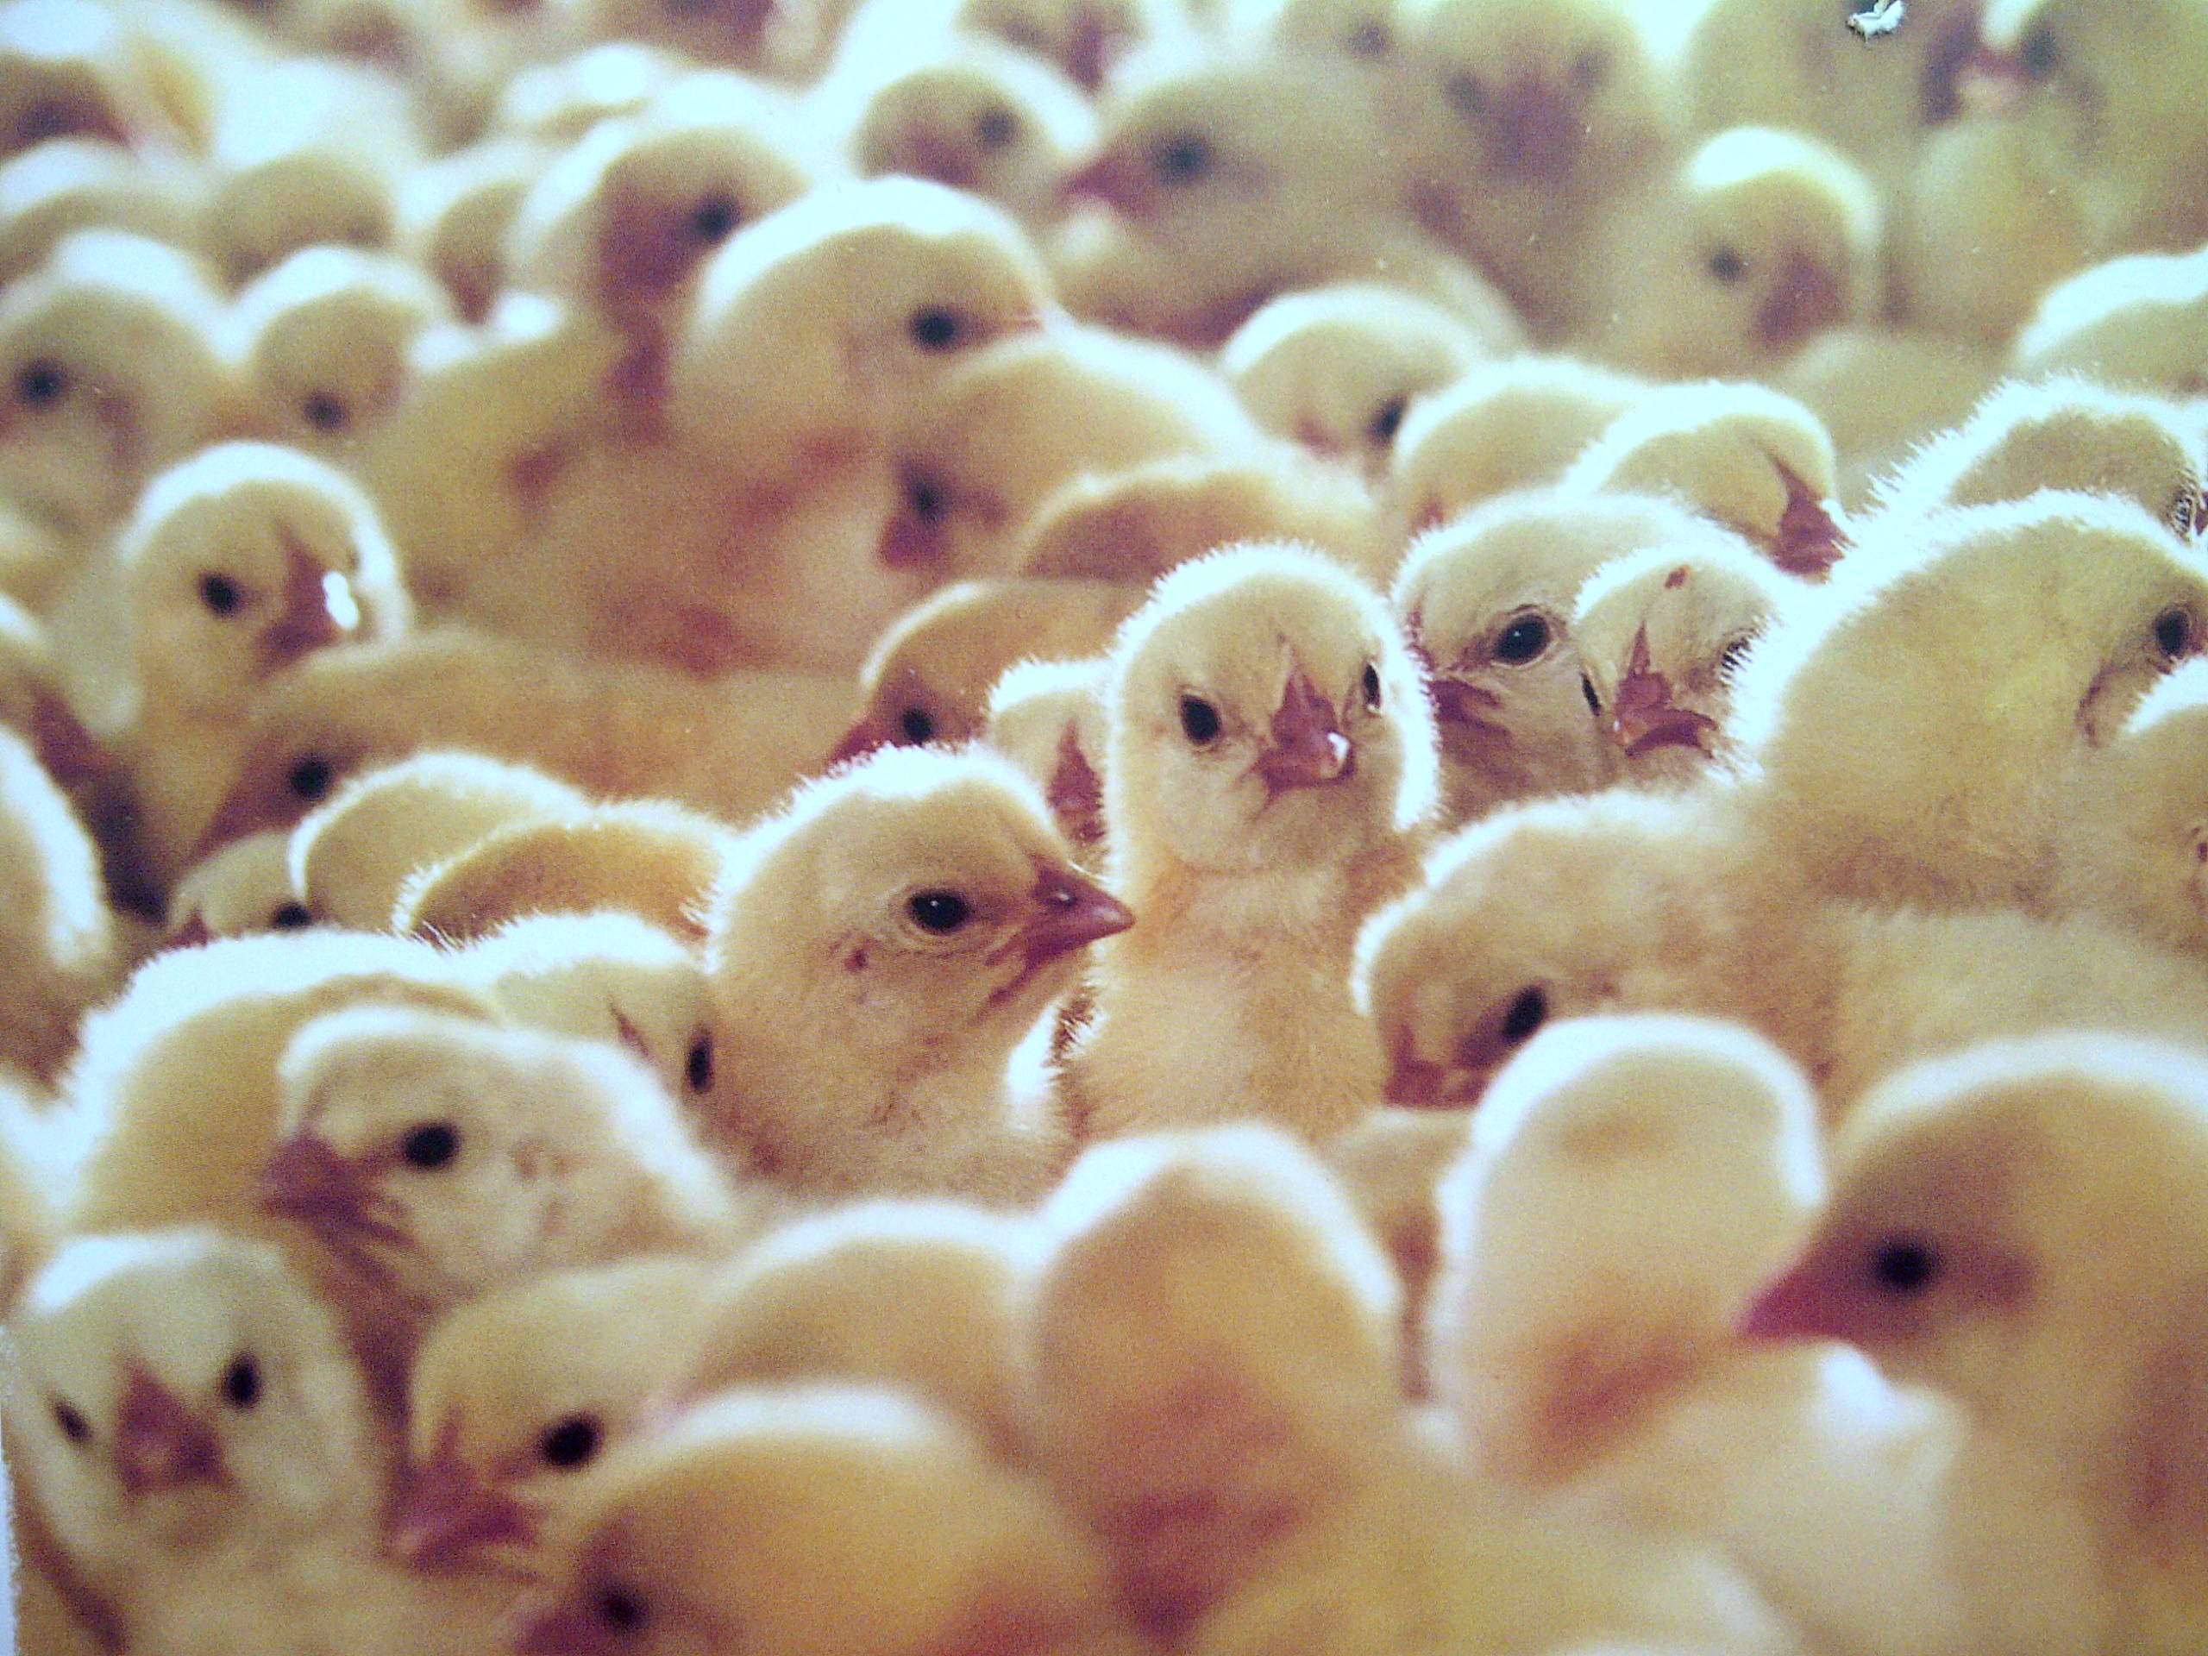
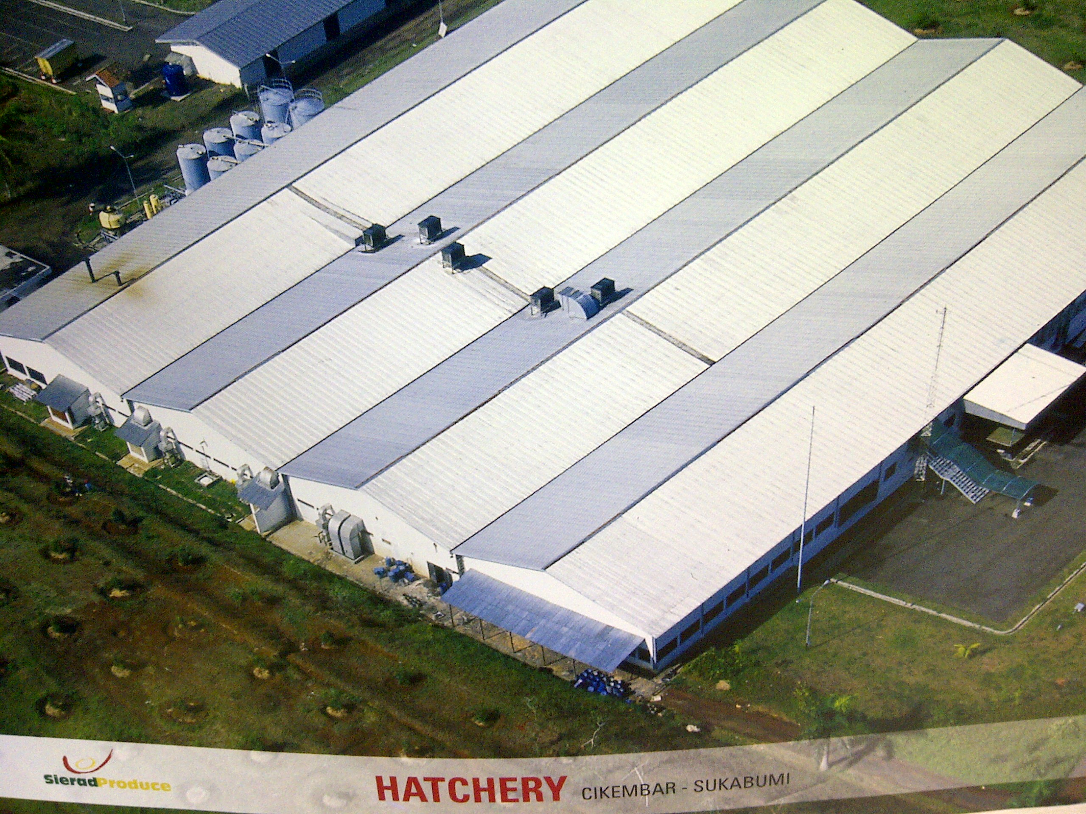
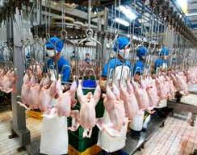
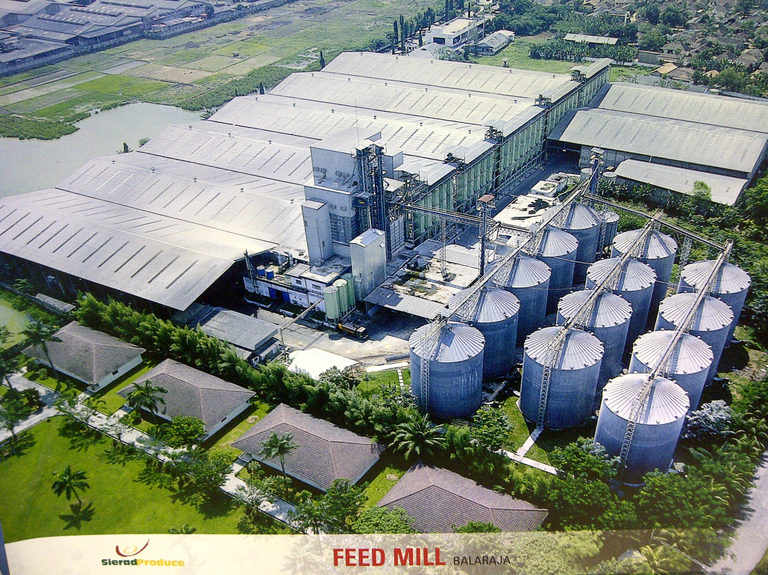
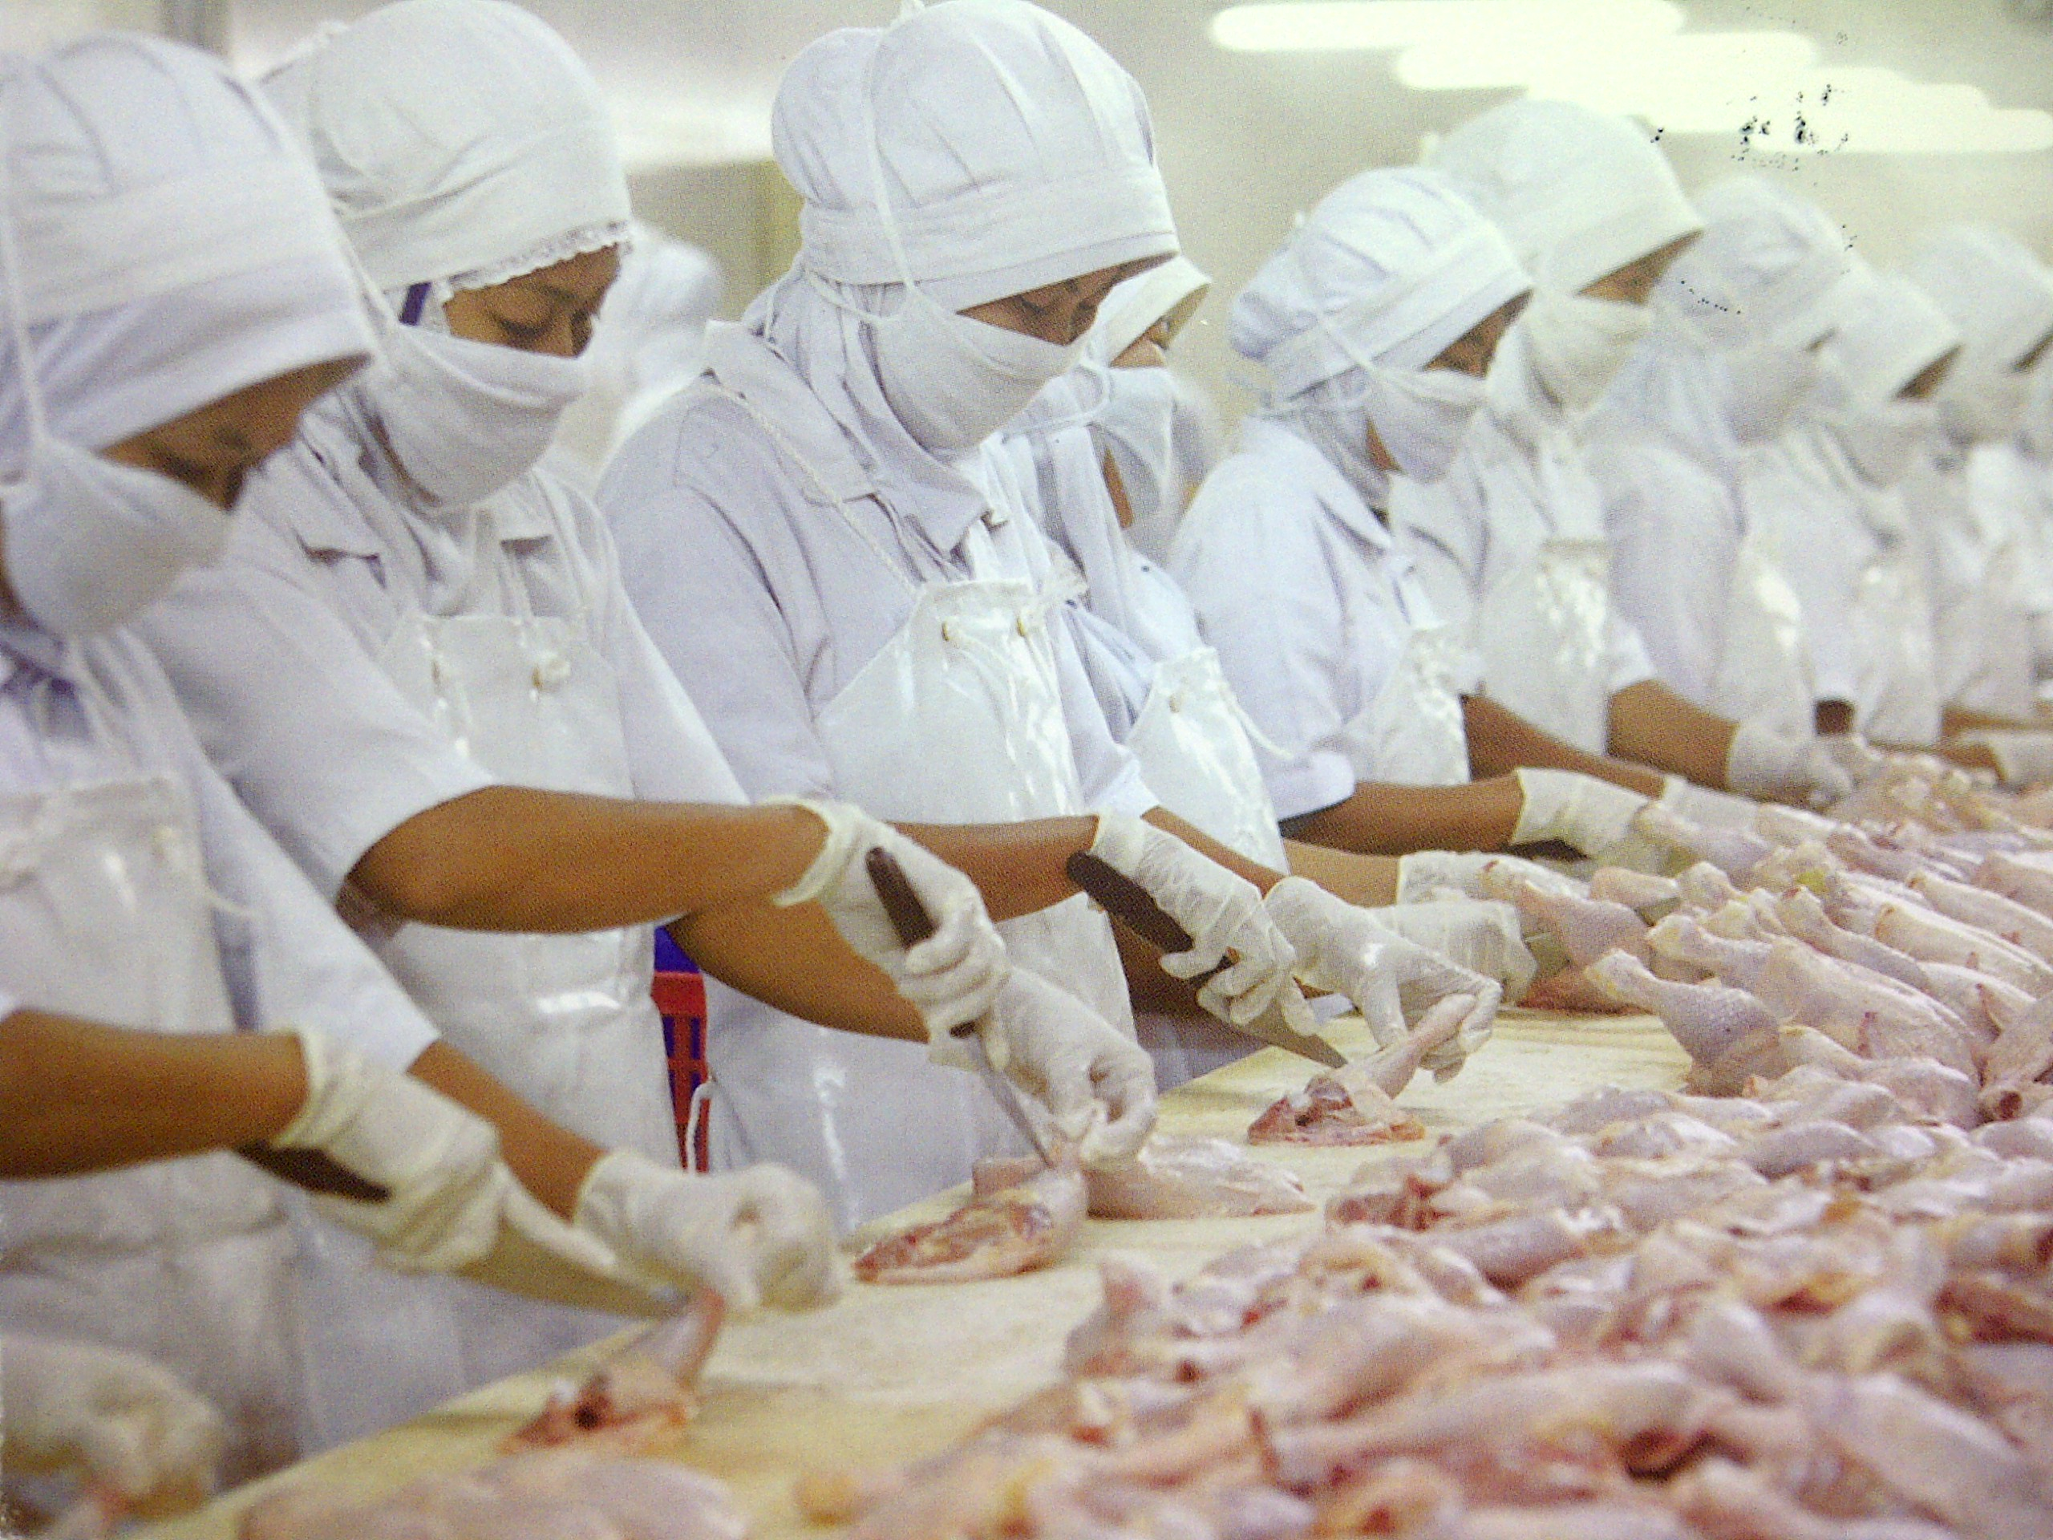
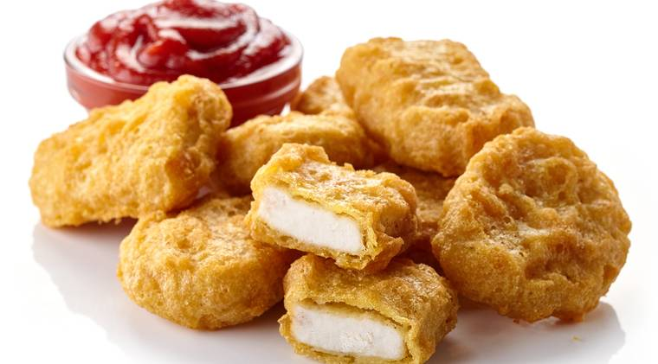
Integrated Poultry Company
Breeding Farm
Hatchery
Broiler Farm
Slaughter Housing
Feedmill
Further Processing

Slide 15
Poultry Logistics requirements
Parameters:
a. Egg → temperature 16 degree celcius, humidity 75%
b. DOC → temperature 21c - 27c
c. Live Bird → avoiding stress caused by too hot or too cold, need to check during
delivery
d. Dressed chicken → frozen: minus 18 degree celcius & fresh: (-) 2 – (+) 2 c
e. Nugget → minus 18 degree celcius
Logistics truck:
a. Egg → closed truck with proper ventilation system
b. DOC → closed truck with proper ventilation system
c. Live Bird → open dry truck
d. Dressed chicken → refrigeration truck
e. Nugget → refrigeration truck

Slide 16
What are Competencies?
Definition
COMPETENCIES
What superior performers do more often, more completely and consistently
Observable behaviours that “make a difference”
The “how” side of performance
BEHAVIORS
(actions)
OUTPUTS
ORGANIZATION
RESULTS
Source: Shannon & Deng, 2008

Slide 17
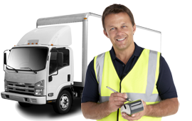
Job Titles involved in logistics delivery process
a. Adm. Sales / Create order
b. Adm. Gudang / proses order
c. Picker / Penyiapan order
d. Checker
e. Transport planner / Penyiapan kendaraan
d. Driver
e. Logistics Supervisor
f. Logistics Manager
g. Logistics Head

Slide 18
Competencies in Poultry Logistics
Commodity/ product knowledge
  Loss or damage in delivery process
  Characteristics
Animal welfare knowledge
Skills on handling Poultry commodity/ product during delivery
Logistics Administration
Uptitude for technology
Customer focused
Logistics key performance indicators measurement
Accountability/ responsibility
Planning & Organizing

Slide 19
Competencies Mapping
No | Competency | Adm Sales | Adm Whse | Picker | Checker | Transport Planner | Driver | Logistics Spv | Logistics Mgr | Logistics Head
1 | Product Knowledge | 2 | 2 | 2 | 2 | 2 | 3 | 3 | 4 | 4
2 | Animal welfare | 2 | 2 | 2 | 2 | 3 | 3 | 3 | 4 | 4
3 | Delivery handling | 2 | 2 | 3 | 3 | 3 | 3 | 4 | 3 | 3
4 | Logistics administration | 3 | 3 | 3 | 3 | 3 | 2 | 4 | 2 | 2
5 | Uptitute for technology | 1 | 1 | 1 | 1 | 1 | 1 | 3 | 3 | 4
6 | Customer focused | 3 | 3 | 3 | 3 | 3 | 3 | 3 | 4 | 4
7 | Logistics KPIs | 3 | 3 | 3 | 3 | 3 | 3 | 3 | 4 | 4
8 | Accountability/ responsbility | 3 | 3 | 3 | 3 | 3 | 3 | 3 | 3 | 3
9 | Planning & Organizing | 1 | 1 | 1 | 1 | 3 | 1 | 3 | 3 | 4
1=Basic Appreciation, 2=Working Knowledge, 3=Fully Operational, 4=Leading Edge

Slide 20
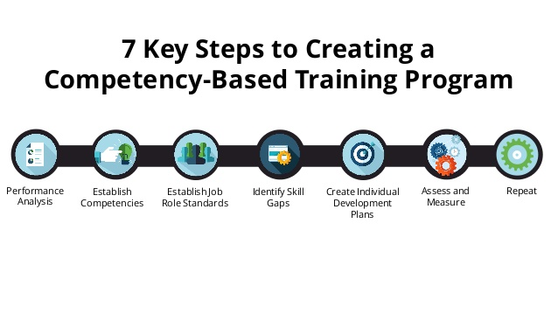
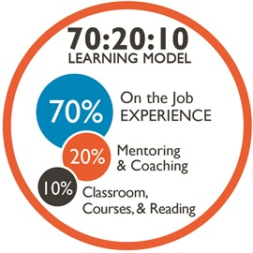

Slide 21
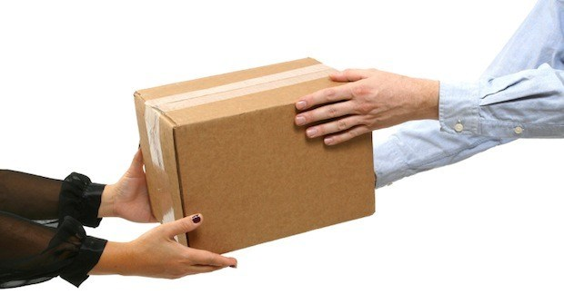
Logistics Roles
“People do not buy products,
They buy d e l i v e r e d products.”

Slide 22
