Slide 1
Competences with a gender dimension
Dr. AnneMarie Westendorp

Slide 2
Education Labour market

Slide 3
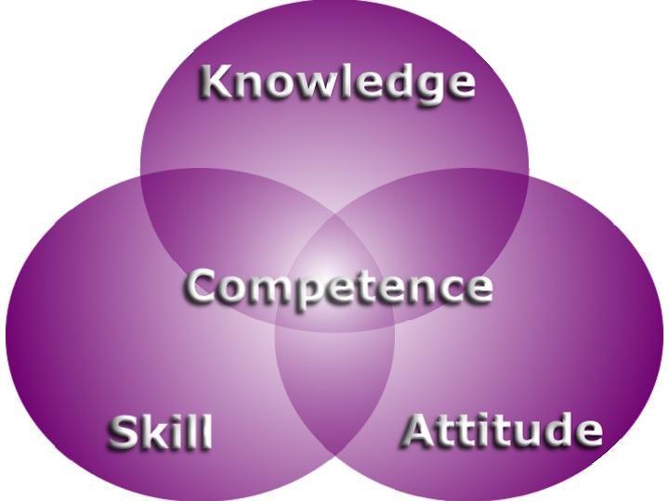
Competence-based education
Knowledge
Skills
Attitude

Slide 4
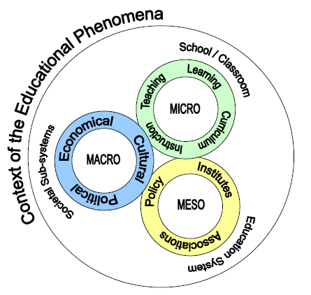

Slide 5
Students should be able to perform in both professional environments and should develop skills to maintain a critical and pro-active attitude towards their personal development.

Slide 6
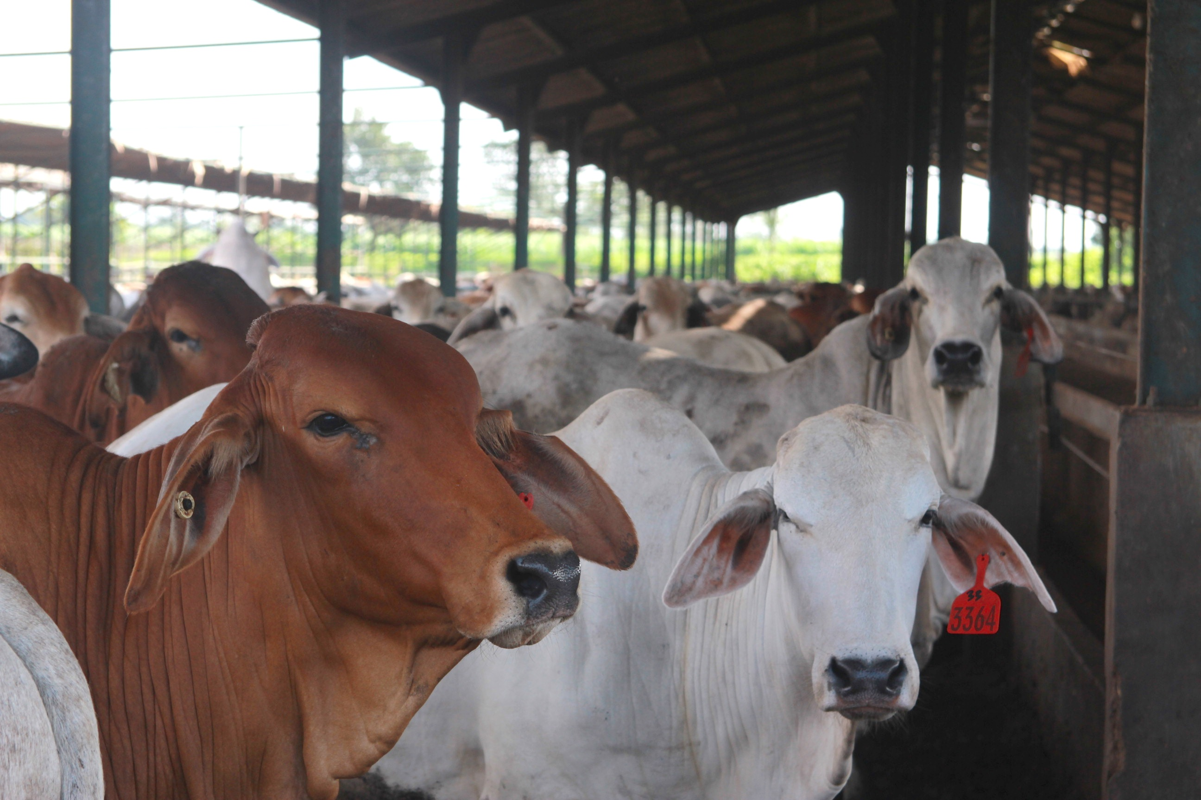

Slide 7


Slide 8


Slide 9
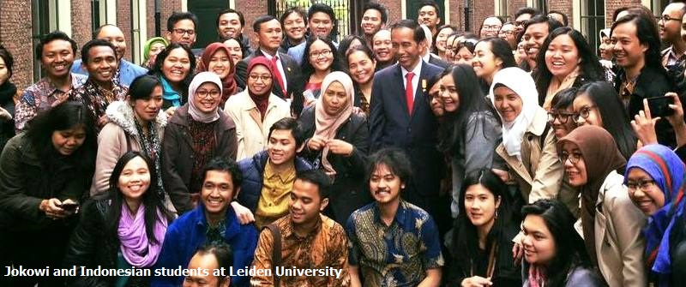

Slide 10
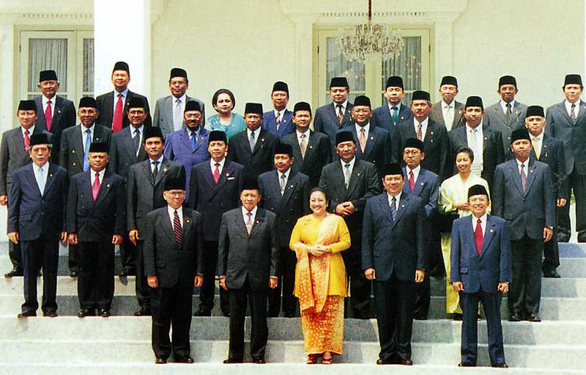

Slide 11
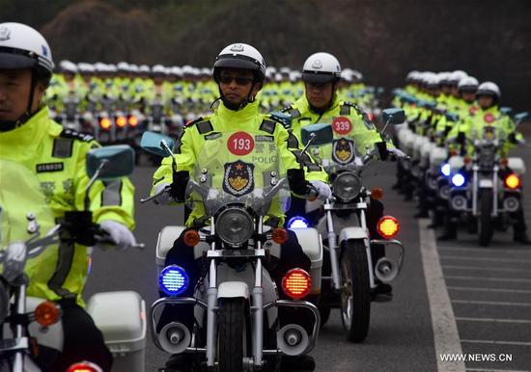

Slide 12
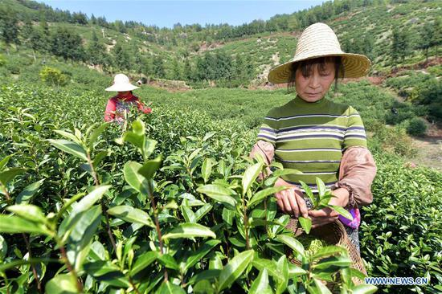

Slide 13
Gender: men and women
Different roles
Different interests
Different needs
Differences in access and decision-making of resources

Slide 14
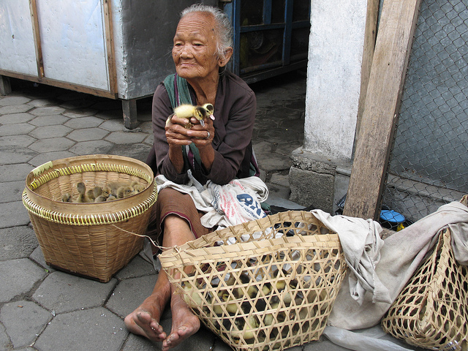

Slide 15
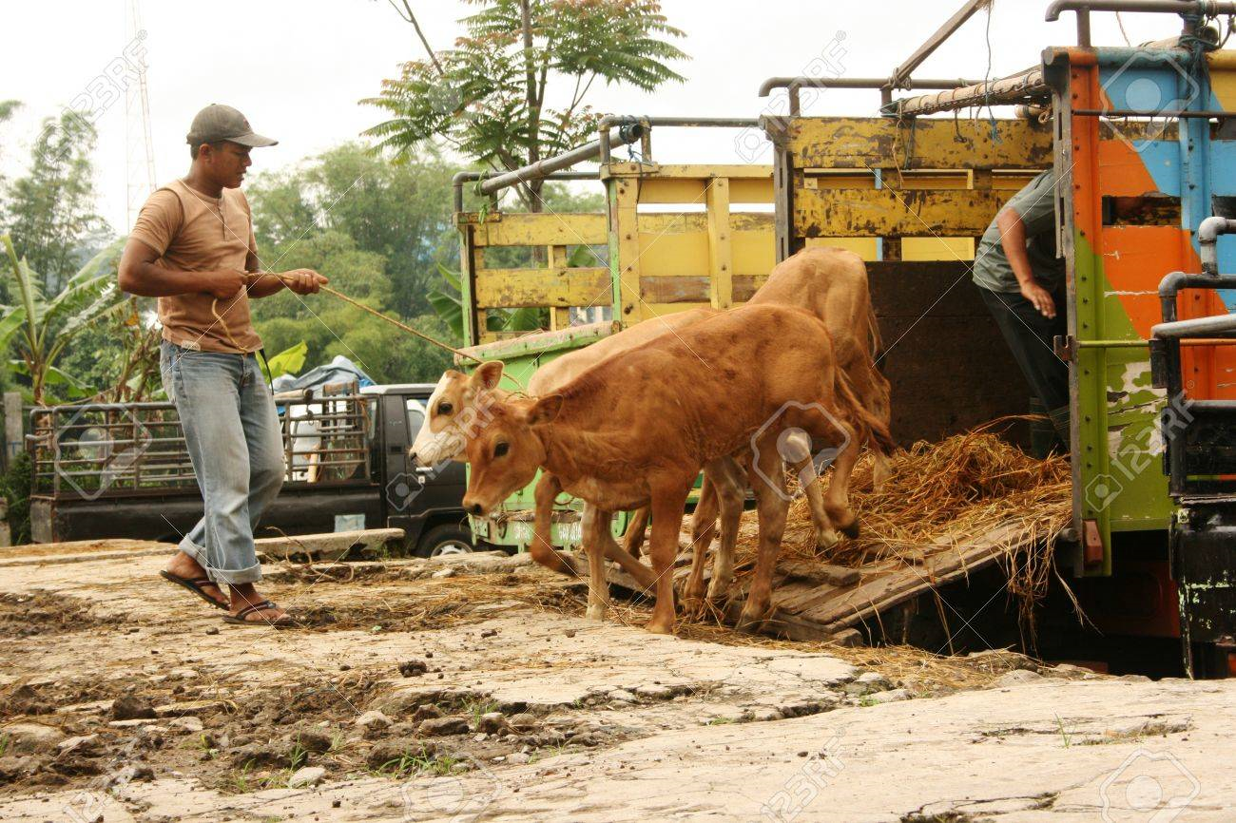

Slide 16
CBE in the Indonesian Higher Education system might be the trigger of a social and cultural change.

Slide 17


Slide 18
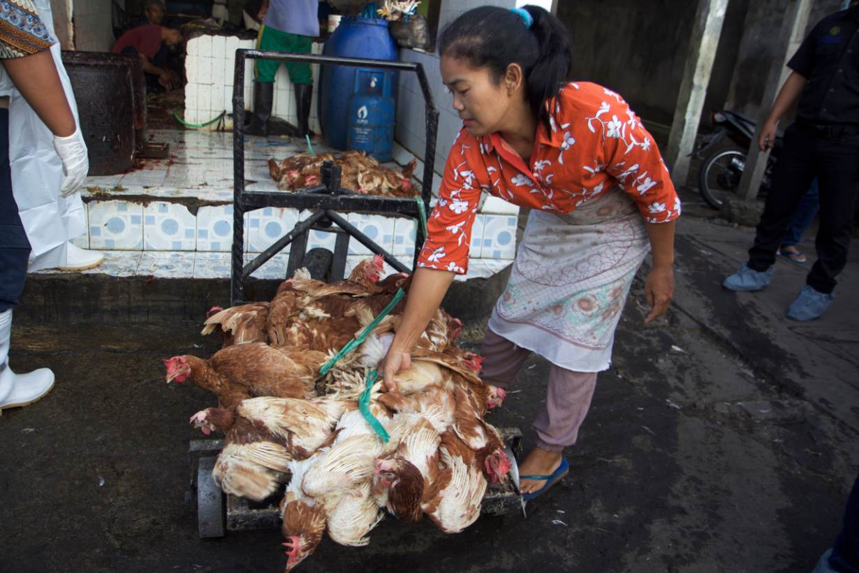

Slide 19
Labour conditions
Equal pay
Safety
Opportunity to get training
Market access
Access to information
Decision-making

Slide 20


Slide 21
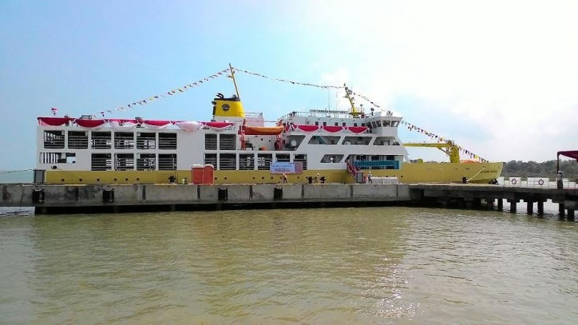

Slide 22
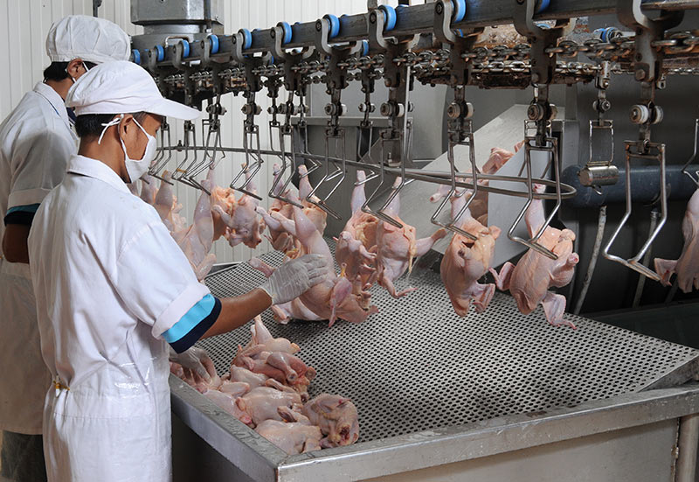

Slide 23
Thank you
Terima Kasih

