Slide 1


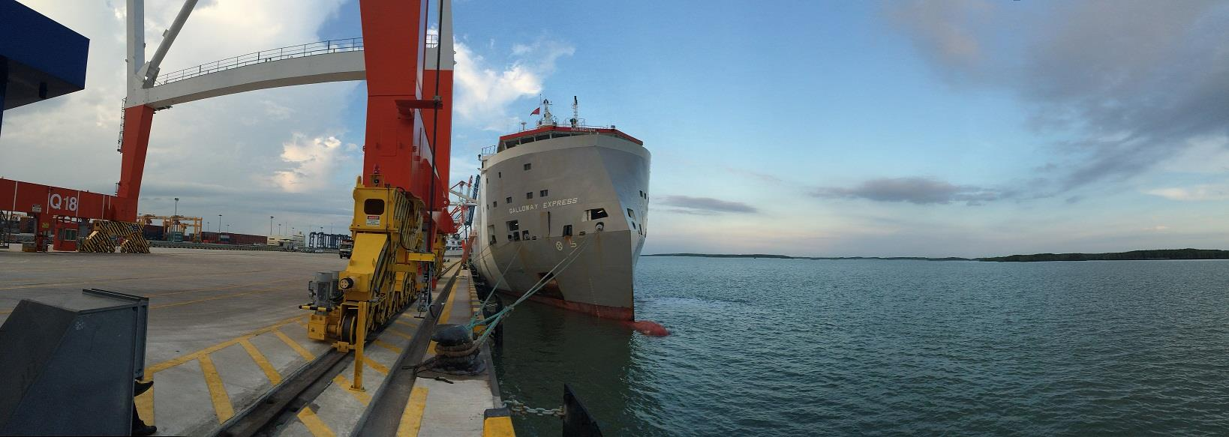


LIVESTOCK EXPRESS
ANIMAL WELFARE: THE ROLE OF SHIP OWNERS
AUGUST 29TH, INDONESIA

Slide 2
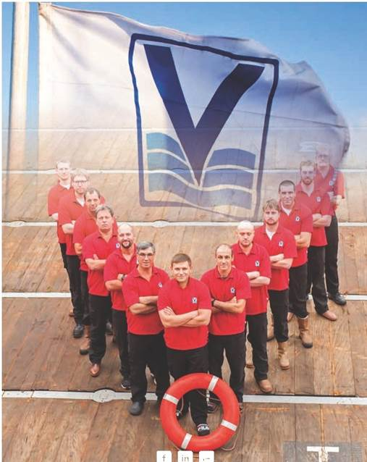
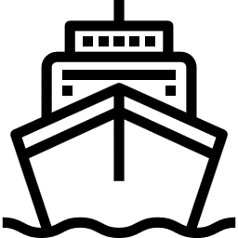



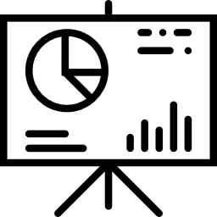

COMPANY PROFILE
160
ships
4,500
professionals
Privately
held
126 years
in business
Proven
track record
Active in
8 shipping
segments
EXPECT US TO DELIVER

Slide 3
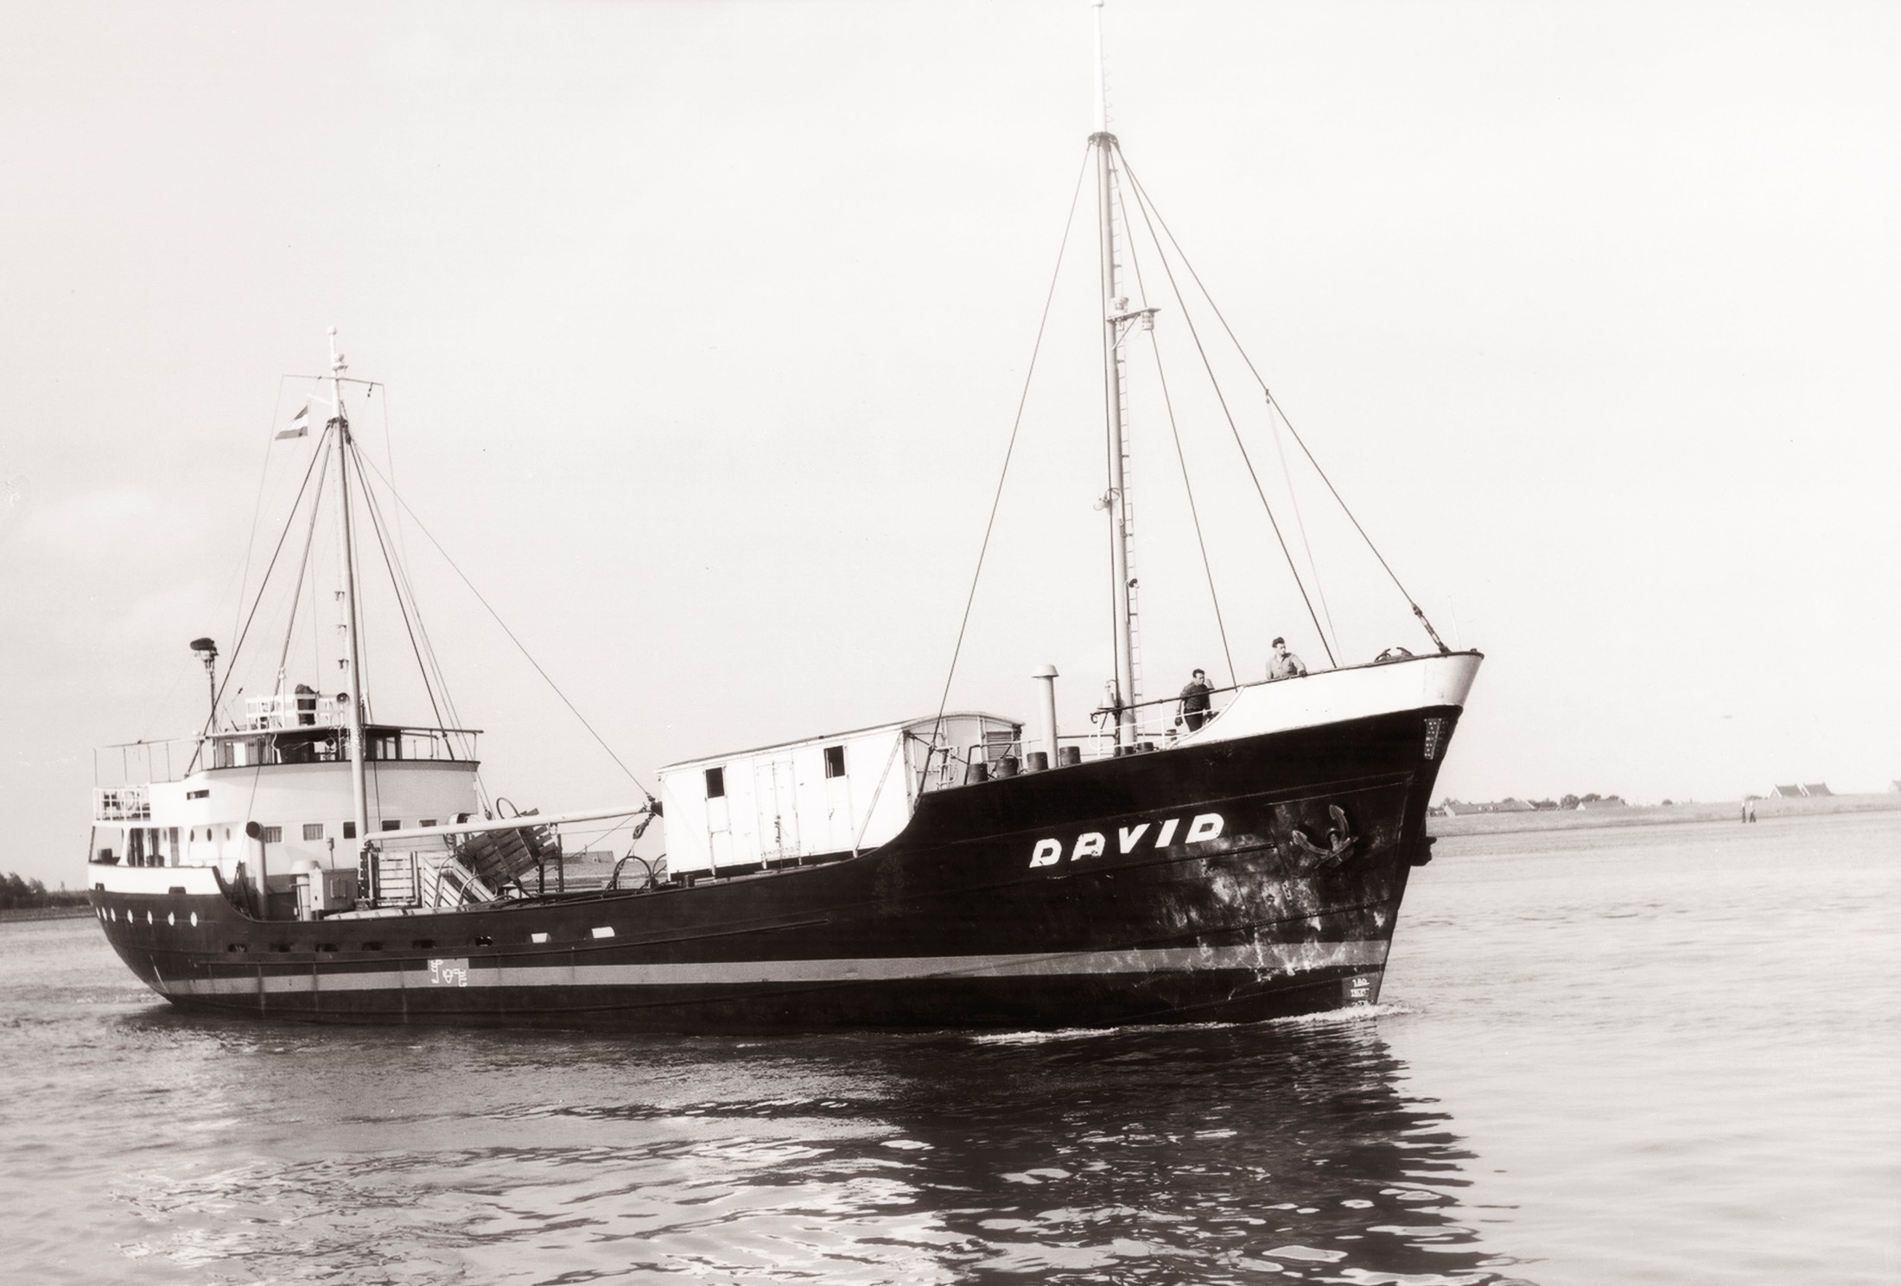

HISTORY
Over 50 years in the livestock business
Largest independent livestock carrier
Purpose built vessels
7 New-build vessels delivered since 2013
Total fleet of 14 livestock vessels
Vessels featuring the greatest animal welfare standards
Shipping abt. 500,000 cattle per year

Slide 4
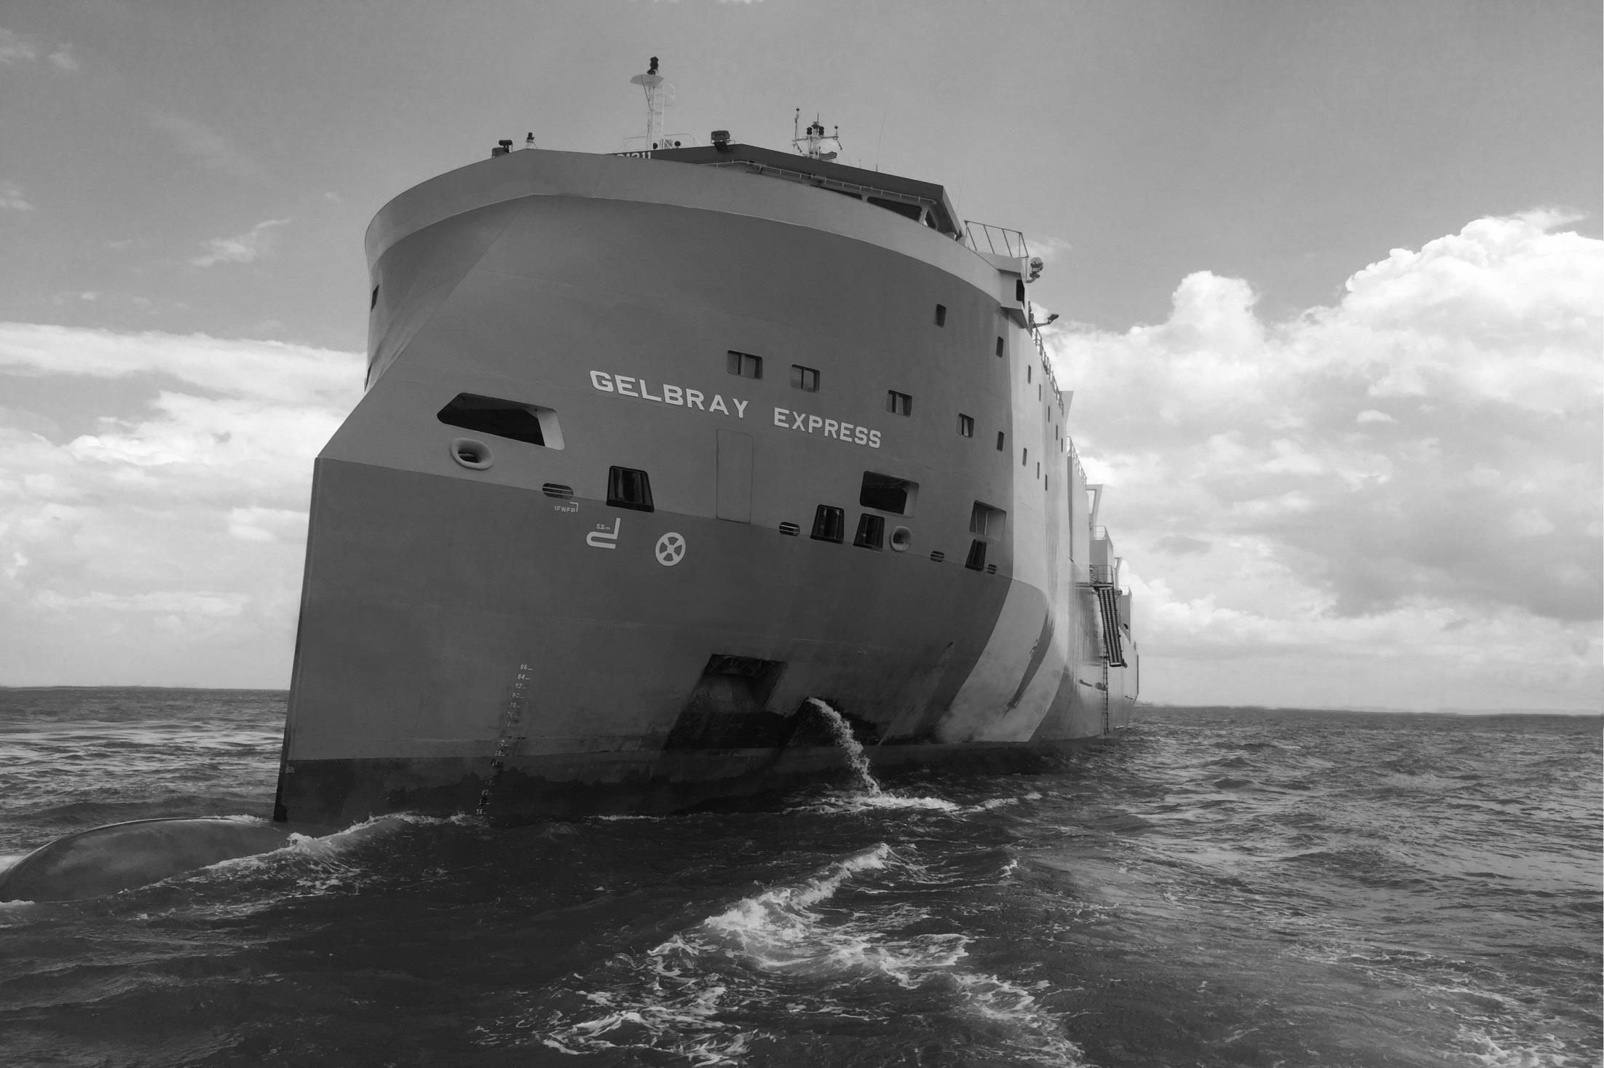
ELEMENTS IMPERATIVE FOR SAFE AND HUMANE TRANSPORTATION
CATTLE PREPARATION (EXPORTERS RESPONSIBILITY)
DESIGN PHILOSOPHY (PURPOSE-BUILT FLEET):
  Ventilation
  Fresh water storage and supply
  Fodder storage and feeding systems
  Ship Movement & Stability
  Effluent removal system
  Power redundancy
ON-BOARD MANAGEMENT
  Space allowance
  Voyage routing
  Crew experience

Slide 5
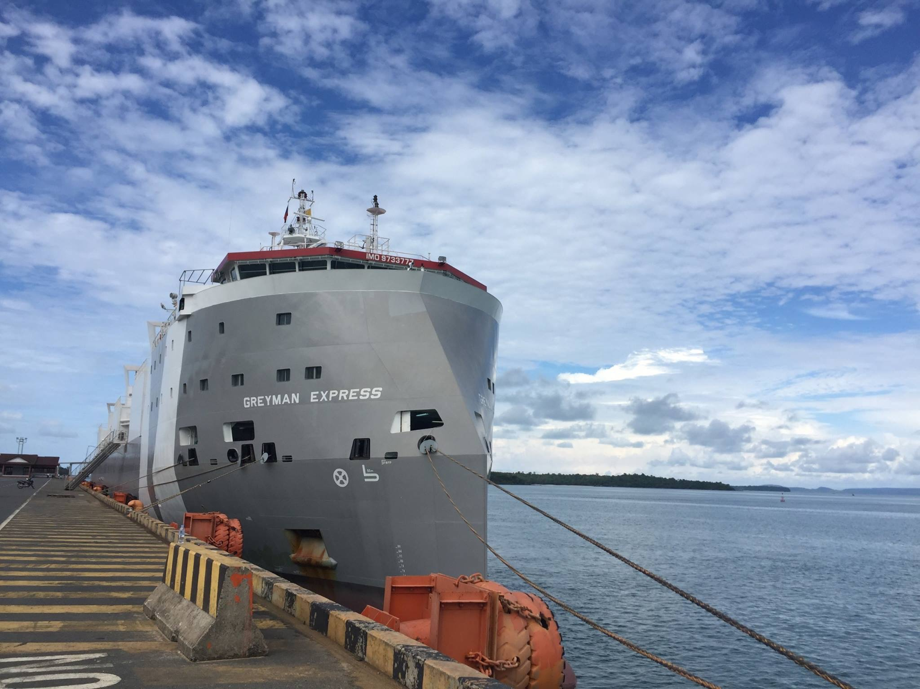
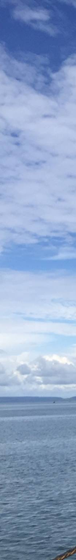
Design philosophy
Tank modelling
Wave-piercing bow design for improved sea-keeping and speed
Only livestock ships with COMFORT rating
Significant reduced noise-levels with increased number of air-changes
Air-flow modelling for optimal ventilation
PROVEN TRACK RECORD
0.058% mortality rate versus 0.11% industry average (Australia)

Slide 6
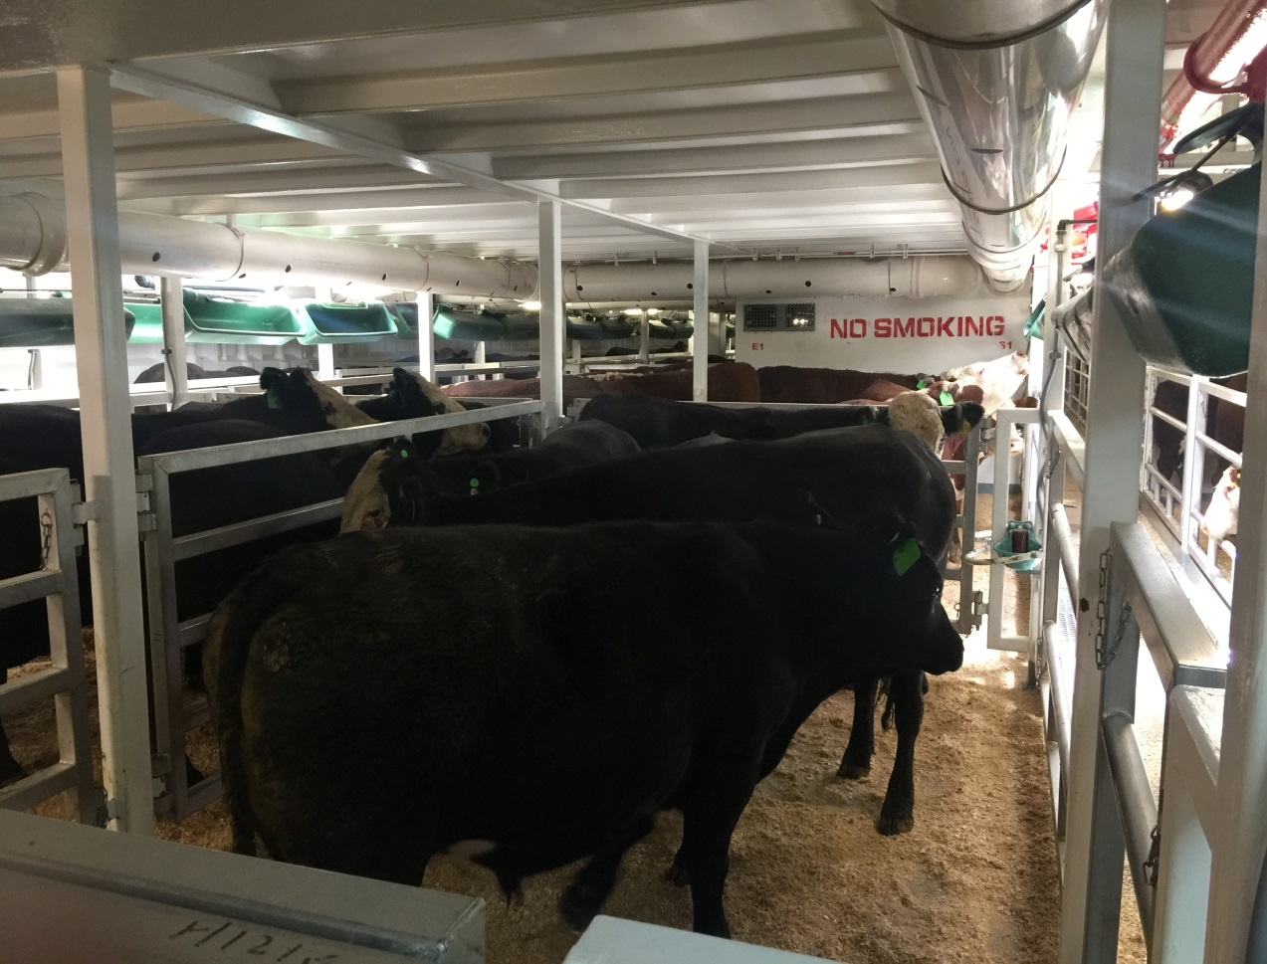
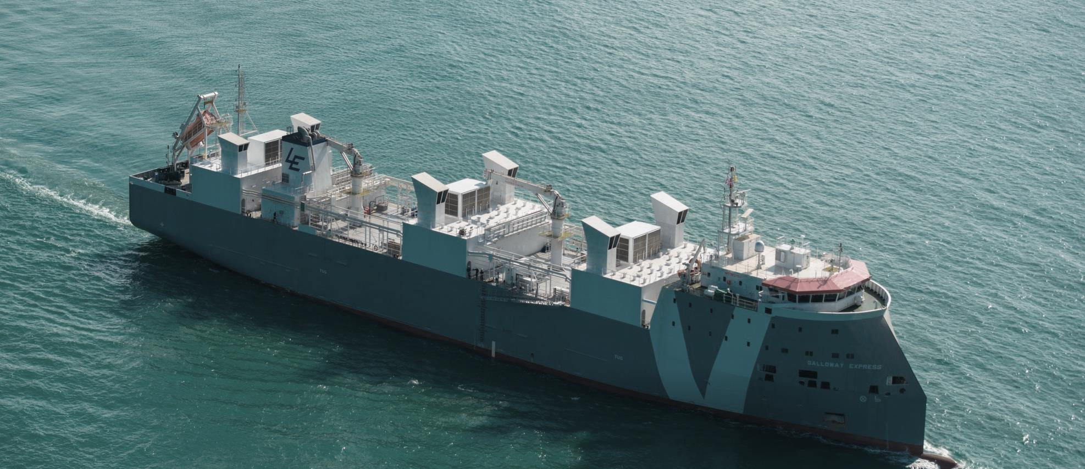
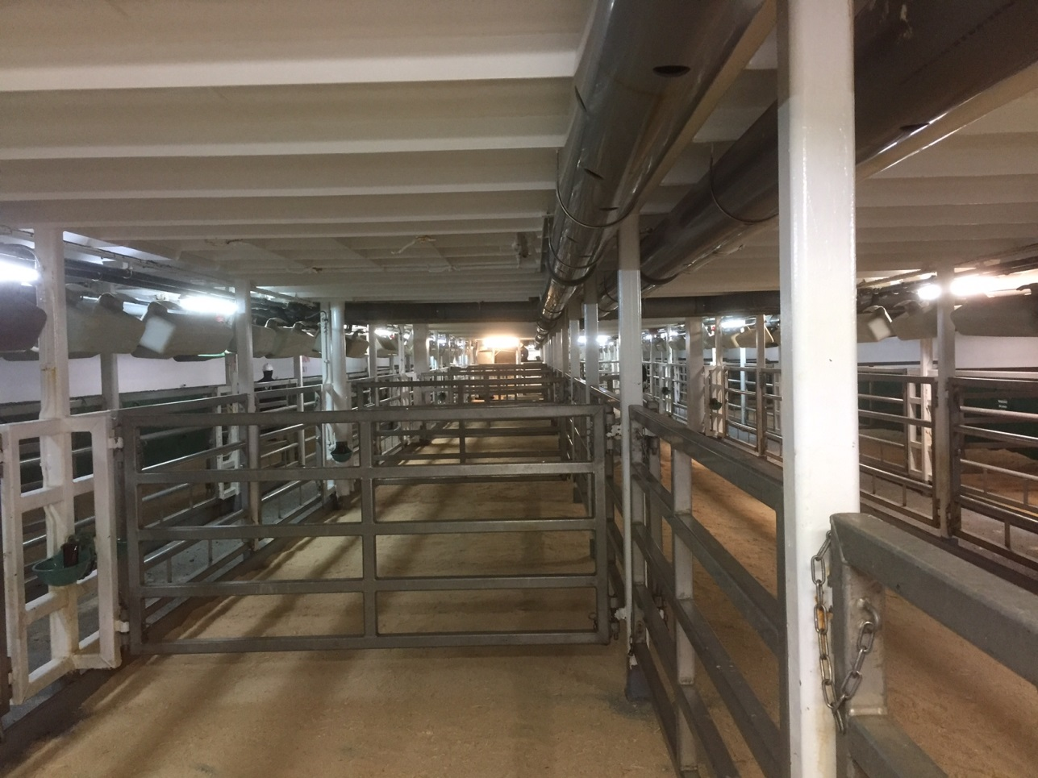
IMPROVED SAFETY AND EFFICIENCY
Power-redundancy
Advanced Monitoring and alarm systems for ventilation and water-system
2 Reverse Osmosis systems each producing 100 cub/day
CCTV in cargo holds
Longitudinal pen design

Slide 7

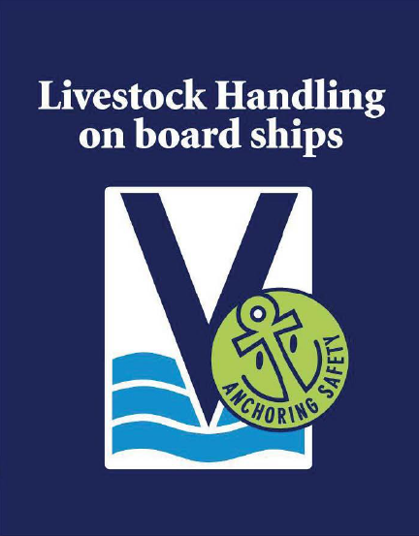
Principles for on-board management
OIE Guidelines Chapter 7.2 (Transport of Animals by Sea)
Crew training and experience – Livestock Handling Manual

Slide 8
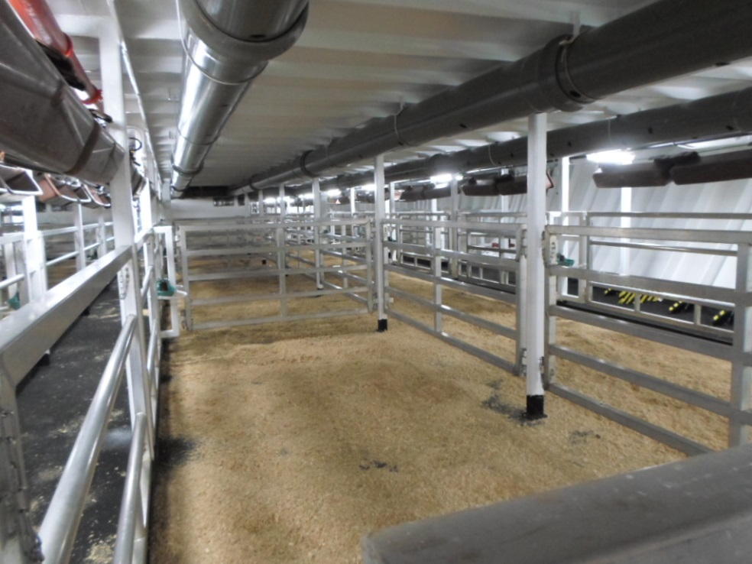
Preloading preparations
Cargo Hold Cleaning, Disinfection & Fummigation
Testing of all livestock equipment
Pens, passage ways – possible distractions
Spread of beddings

Slide 9
Loading
No sharp and pointed sticks and no use of electrical prodders
Flight zone
  NEEDS
They want to be worked quietly
The want to follow the other animals
They want to be respected, not abused

Slide 10
During the voyage
Vessel routing – SPOS Weather Monitoring
Daily activities
  Regular watering & feeding
  Cleaning troughs & water bowls
  Washing (long-haul voyages)
  Daily stockman meeting & report
24/7 Cattle and hold condition monitoring:
  Leg problems, weakness, illness, heat stress, respiration, appetite, discharges
  Adjust pen stocking densities, utilize hospital pens, notify stockman/vet
  Checks on water pressure, overflowing bowls, ventilation (automatic alarms), lighting, bilge level
  Measurement temperatures (dry/wet/humidity)

Slide 11
