Slide 1
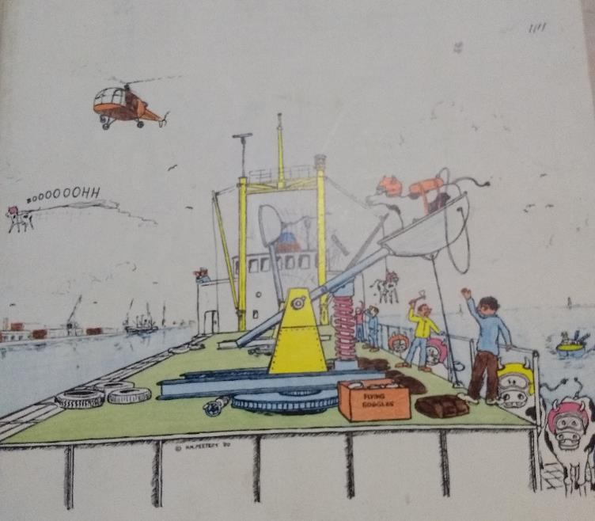
Livestock Logistics
Frits Blessing, 29 August 2018, FPLI

Slide 2
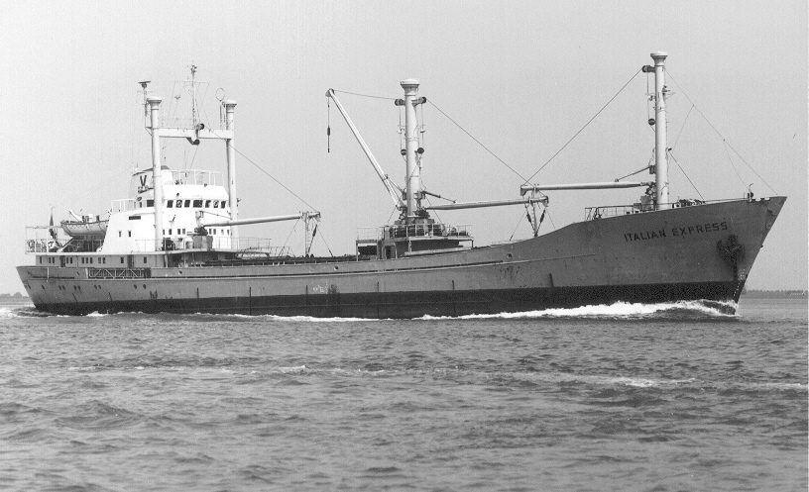
Singapore Flag, Indonesian Crew

Slide 3
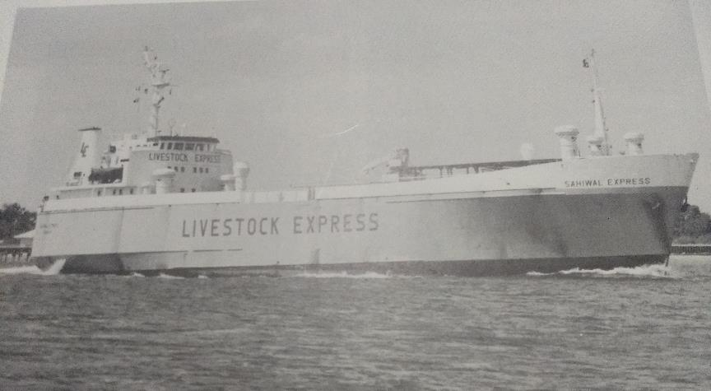
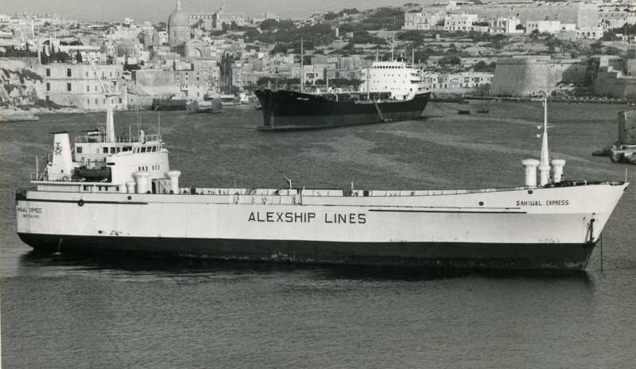
My first livestock vessel to Cilacap

Slide 4
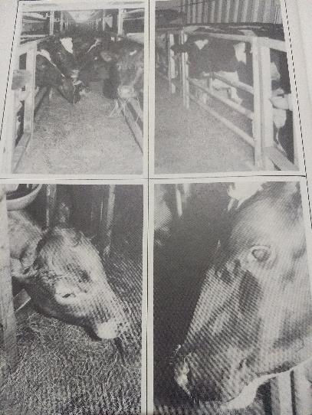
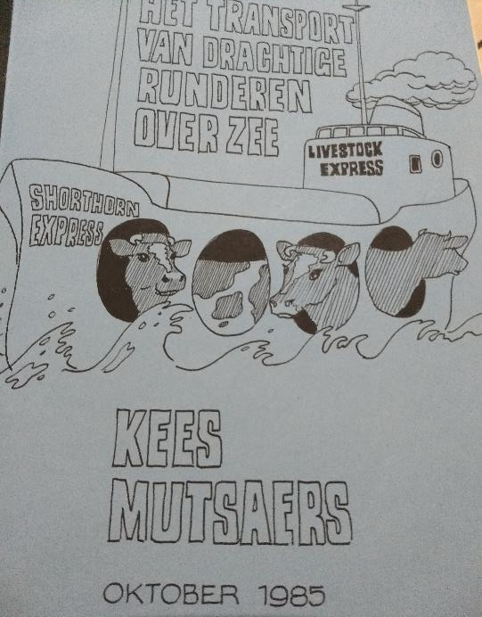
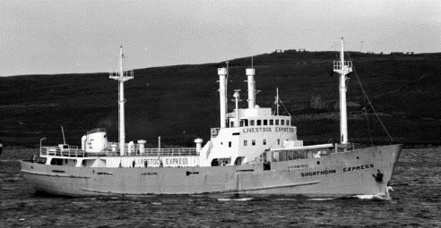

Slide 5
Working across industries & sectors
Positions
  Shipbased
  IT, Software & Data Services
  Shipping Company
  Sector Project Jakarta
  Program Development & Consultancy
  Inland shipping
  Part-time Professor Global Supply Chains & ICT at Rotterdam University
  Investor / start-ups

Slide 6
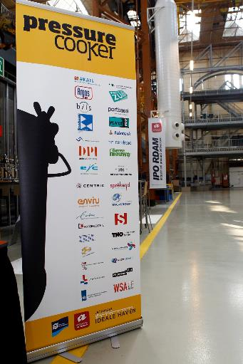
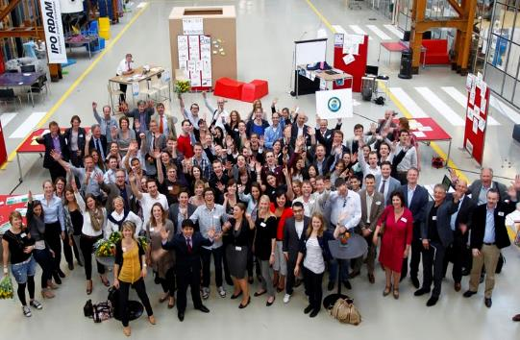
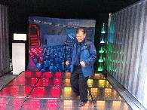

Rotterdam University oaS
RDM Campus
Chair on Global Supply Chains
Developed numerous 3-helix programs with government, port companies, logistics industry and health care

Slide 7
Governance needed on 3 levels
Government
Embassies / Ministries
Economic Diplomacy
Knowledge Innovation
Companies
+ Industry Orgs
(Higher)
Research &
Education
Human Capital Agenda(s): Labor Market
Applied Research / Competitive Agenda(s)
Concept Level Bi-National | Sector Level Framework | Labs / Activities

Slide 8

2011 to Indonesia
3 years Living Labs….
Developed numerous 3-helix programs in an international setting in agro-logistics, water & maritime

Slide 9
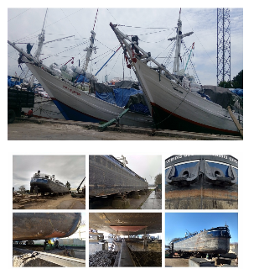
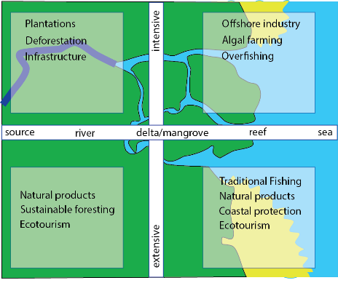
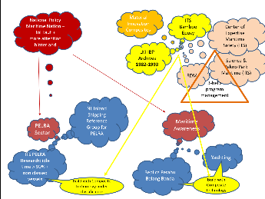


Terimah Kasih
3 – 4 Helix Collaboration:
Learn from other sectors and from other countries
Use experience available
Think out-of-the-box
Create a common understanding

