Slide 1

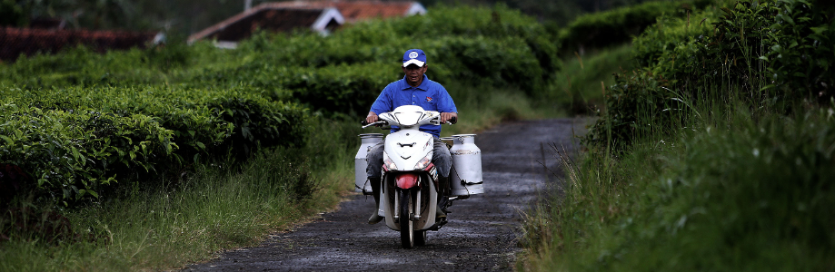
Fresh Milk Supply Chain
Efi Lutfillah – Frisian Flag Indonesia

Slide 2
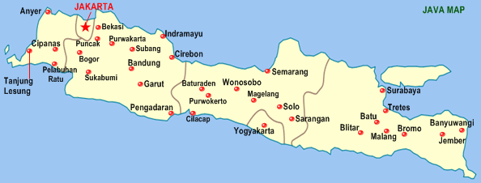
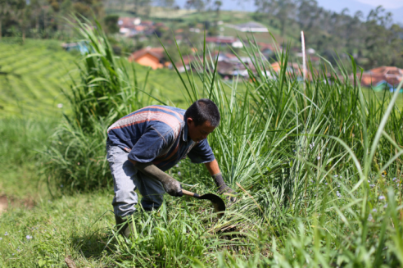
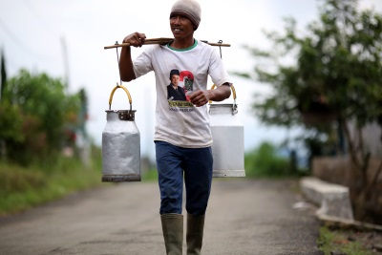
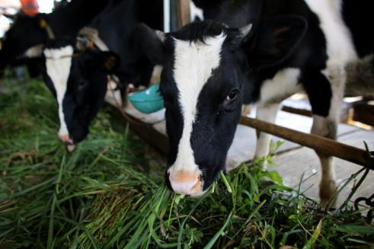
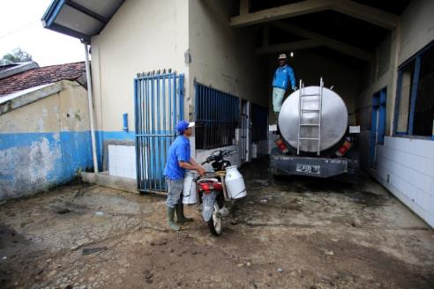
Indonesia Dairy Farmers
conditions and challenges
98% of total milk is produced on Java island, total milk production:
± 1,564 MT/day from approx. 120,000 farmers
Small
holders
dairy farming

Slide 3
Challenges
in Indonesia Dairy Farming
Capacity Building : Staff & Board Coop
Lack of Knowledge
Productivity
CB : Farmer level
Quality
Grass / Roughage
Land Availability
Farmer Welfare
Cow Ownership
Regeneration

Slide 4

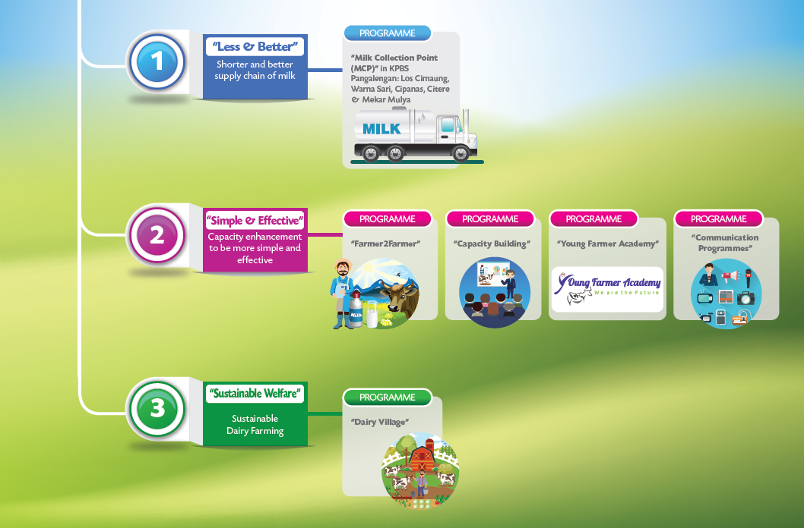
DAIRY DEVELOPMENT PROGRAM

Slide 5
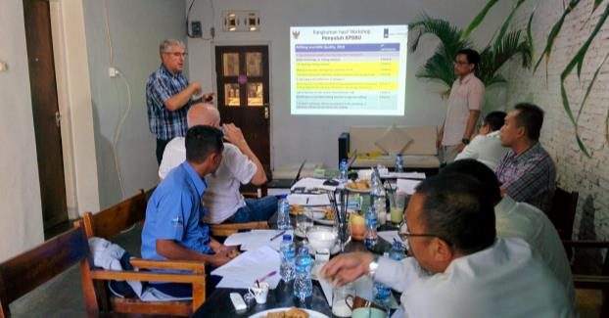
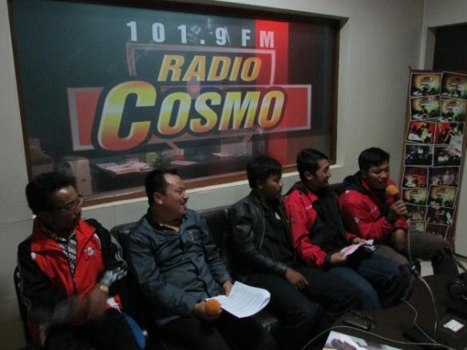
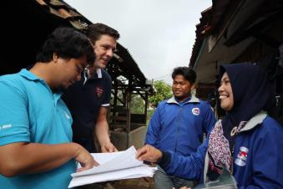
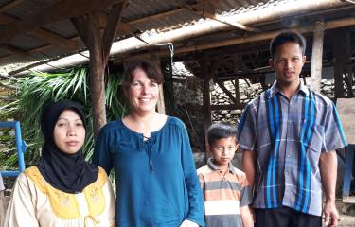
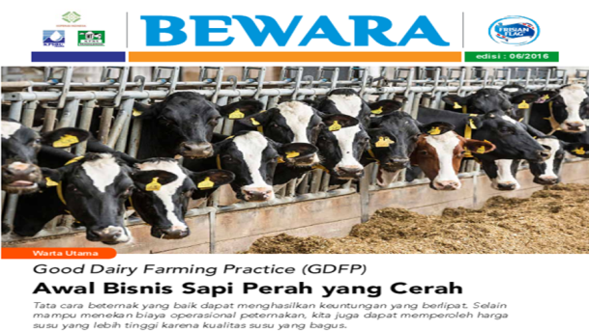
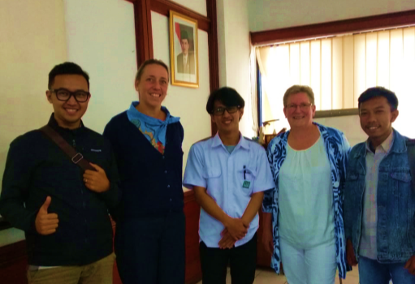
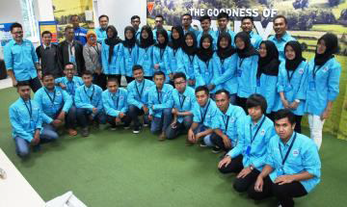
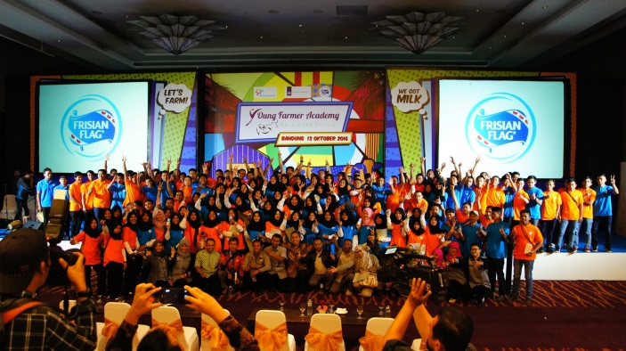
What did FFI support Dairy Farming ?
Human Resources, Finance, Strategic Mngt, Farm Mngt
Capacity Building : Staff & Board
Knowledge
Radio Bewara & Bewara Magazine
CB : Farmer level
Farmer to Farmer
Land Availability
Regeneration
Young Farmer Academy

Slide 6
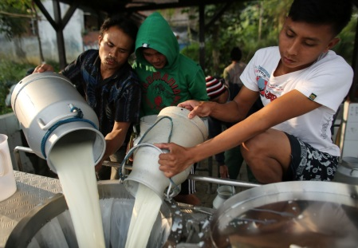
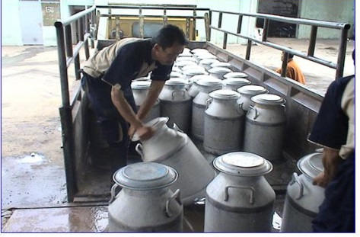
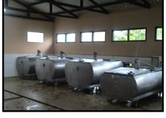
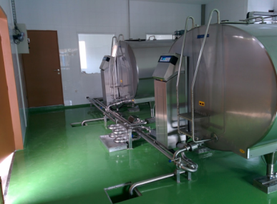
Milk Supply Chain
FARMER
MCP WITHOUT
COOLING
TANKS
COOLING AT
COOPERATIVE
MCP WITH
COOLING TANKS
COOPERATIVE
INDUSTRY
MCP WITH
COOLING TANKS

Slide 7




At Farmer Level
1. DON’T WASHING COWS BEFORE MILKING (DRY MILKING)
Milkcan
Cleaning Udder
First Milking
Filtering
4
1
2. SHORT MILK CHAIN
3
2

Slide 8
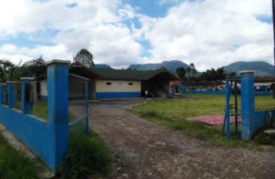
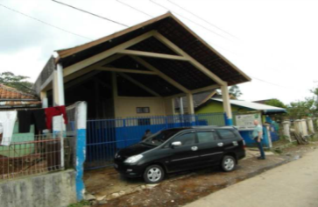
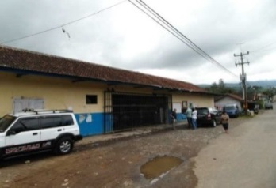
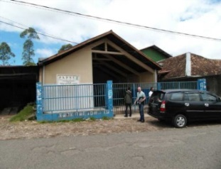
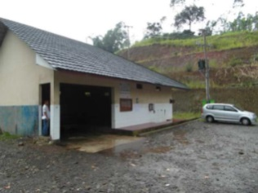
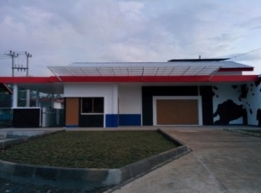
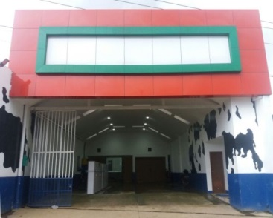
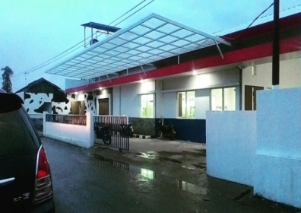
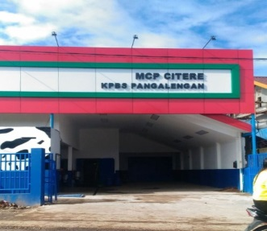
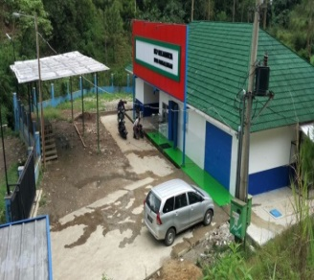

DDP Strategy Pillars & Initiatives
“Less & Better” : Substantially improve the milk quality, through optimization of the network and upgrade of the quality of the Milk Collection Point’s (MCP’s), in combination with improved management capabilities → 7 MCPs already operational at cooperative Pangalengan, involved 1000 local farmers
Los Cimaung
Warna Sari
Cipanas
Citere
Mekar Mulya
Before
1
2
3
4
5
After

Slide 9
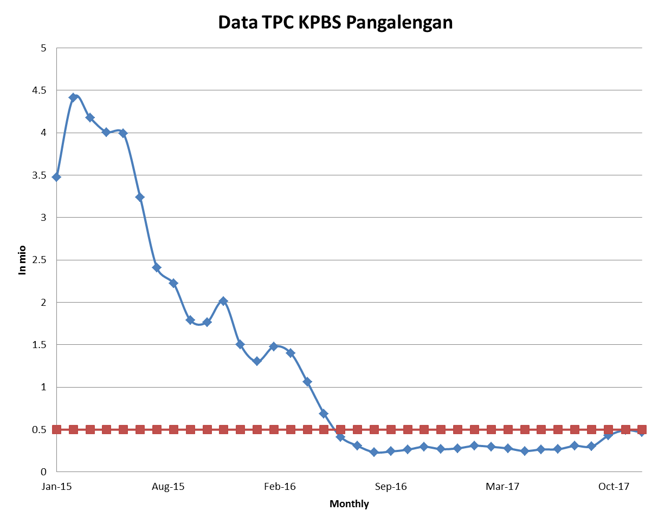
DDP Strategy Pillars & Initiatives
“Result of the Programs” : after implemented those initiatives, quality TPC of fresh milk from KPBS Pangalengan was improved tremendously from 4.5 mio cfu/ml to < 0.5 mio cfu/ml

Slide 10
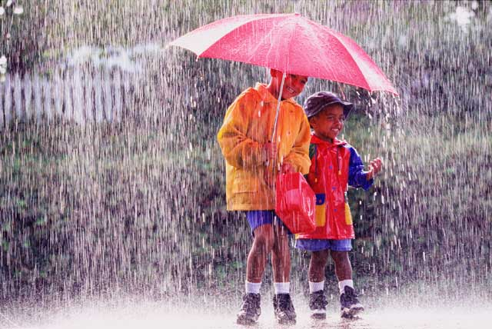
stable design
bedding
cleaning / brushing cows
milking tools (plastic / metal)
handling and desinfection milk. tools
personal hygiene
clean dry towel
udder preparation / mastitis check
milk cans (material)
On farm
milk quality
chain
milking
filtering
time lag milking /collection
cooling
eval. results

Slide 11
Result as strong as weakest link

Slide 12
WHERE IS OUR ROLE ?
SERVICES
EXTENSION
COOPERATIVES
FARMER
GOVERNMENT
BUYING-
SELLING
2. EXTENSION
3. TRANSPARANCY
1. EXTENSION
2. TRANSPARANCY
FACTORY/ MILK PROCESSING
ROLE OF UNIVERSITY AND RESEARCH ?

Slide 13
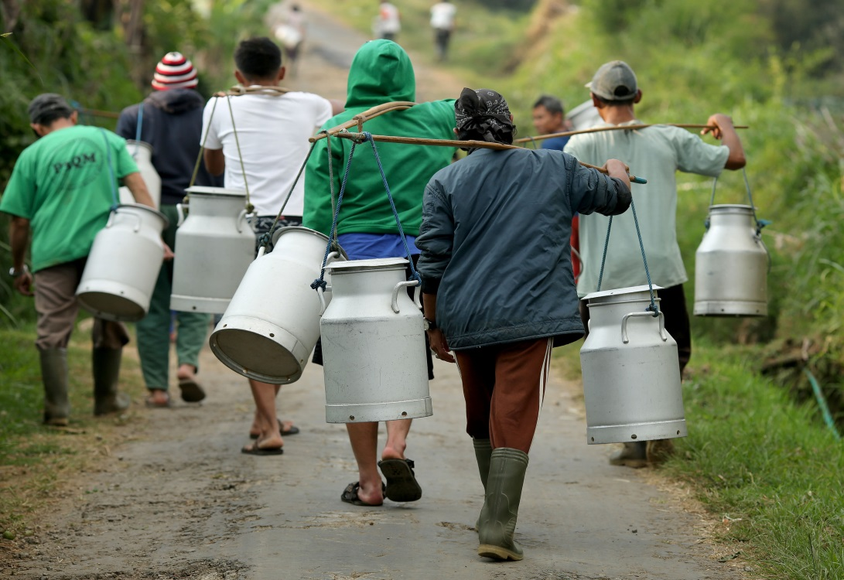
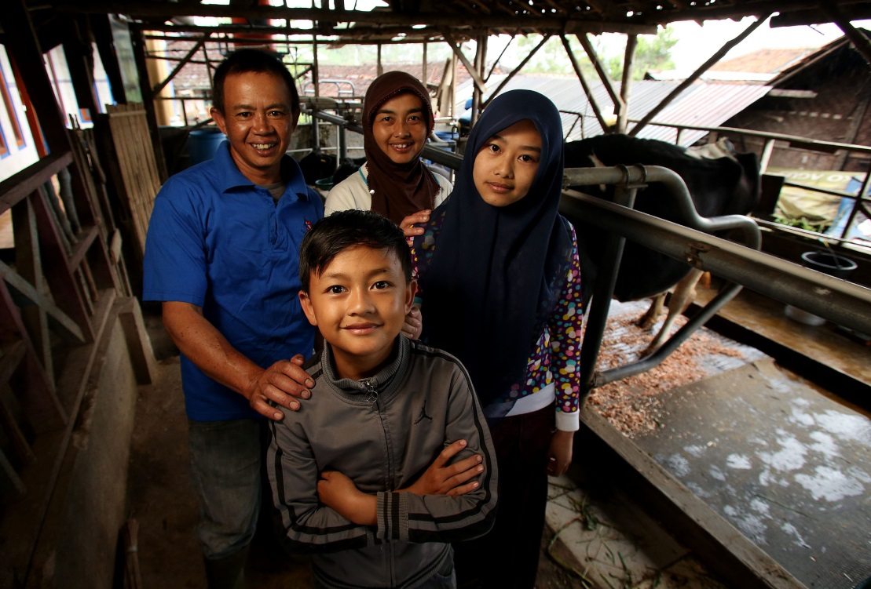
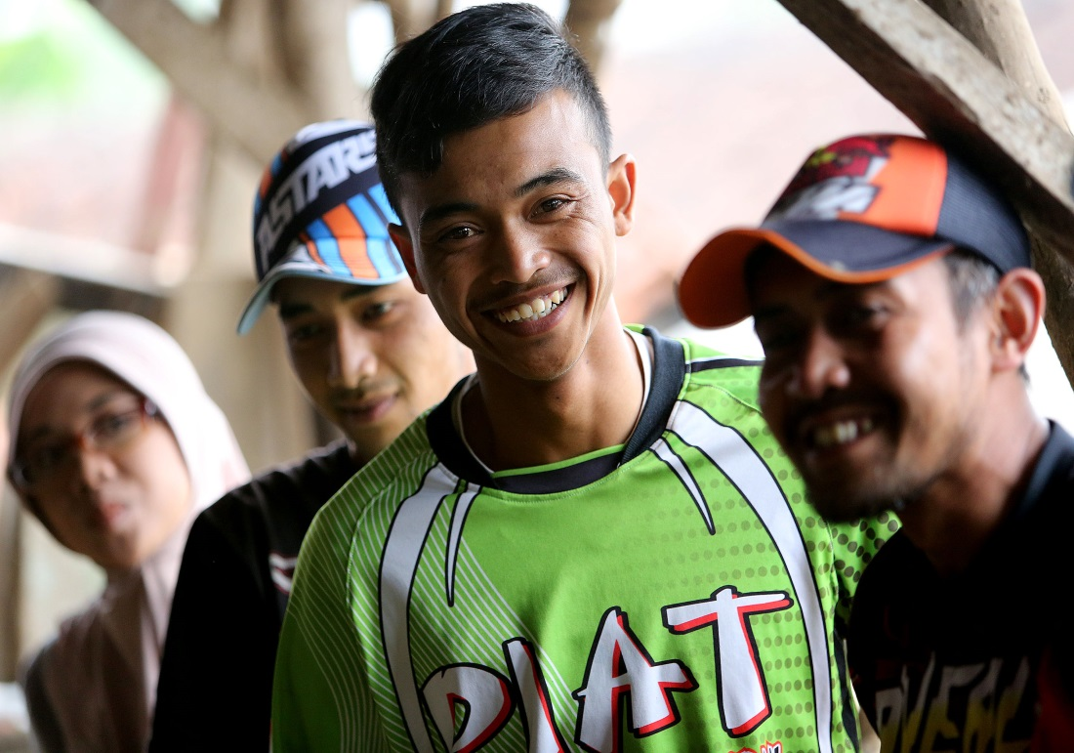

Thank you…..

Slide 14
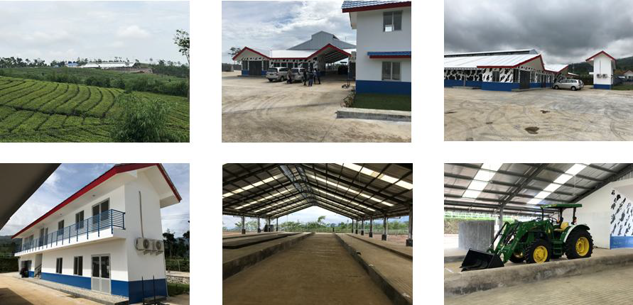
Sustainability walfare

